Slide 1

University of Arizona
Agriculture in Arid Regions: An Introduction

Slide 2
Agriculture in Arid Regions: An Introduction

Slide 3
At the end of today, we will be able to . . .
Define agriculture and understand the importance of agriculture
Describe growing conditions in the Sonoran Desert.
Learn some of the important crops grown in Arizona (arid regions)
Analyze various factors that impact crop choice in arid regions

Slide 4
Part 1: Agriculture
What is agriculture?

Slide 5
Agriculture
Growing and harvesting crops
Raising animals or livestock
Notes:
Lettuce is grown in Yuma, AZ (PHOTO)

Slide 6
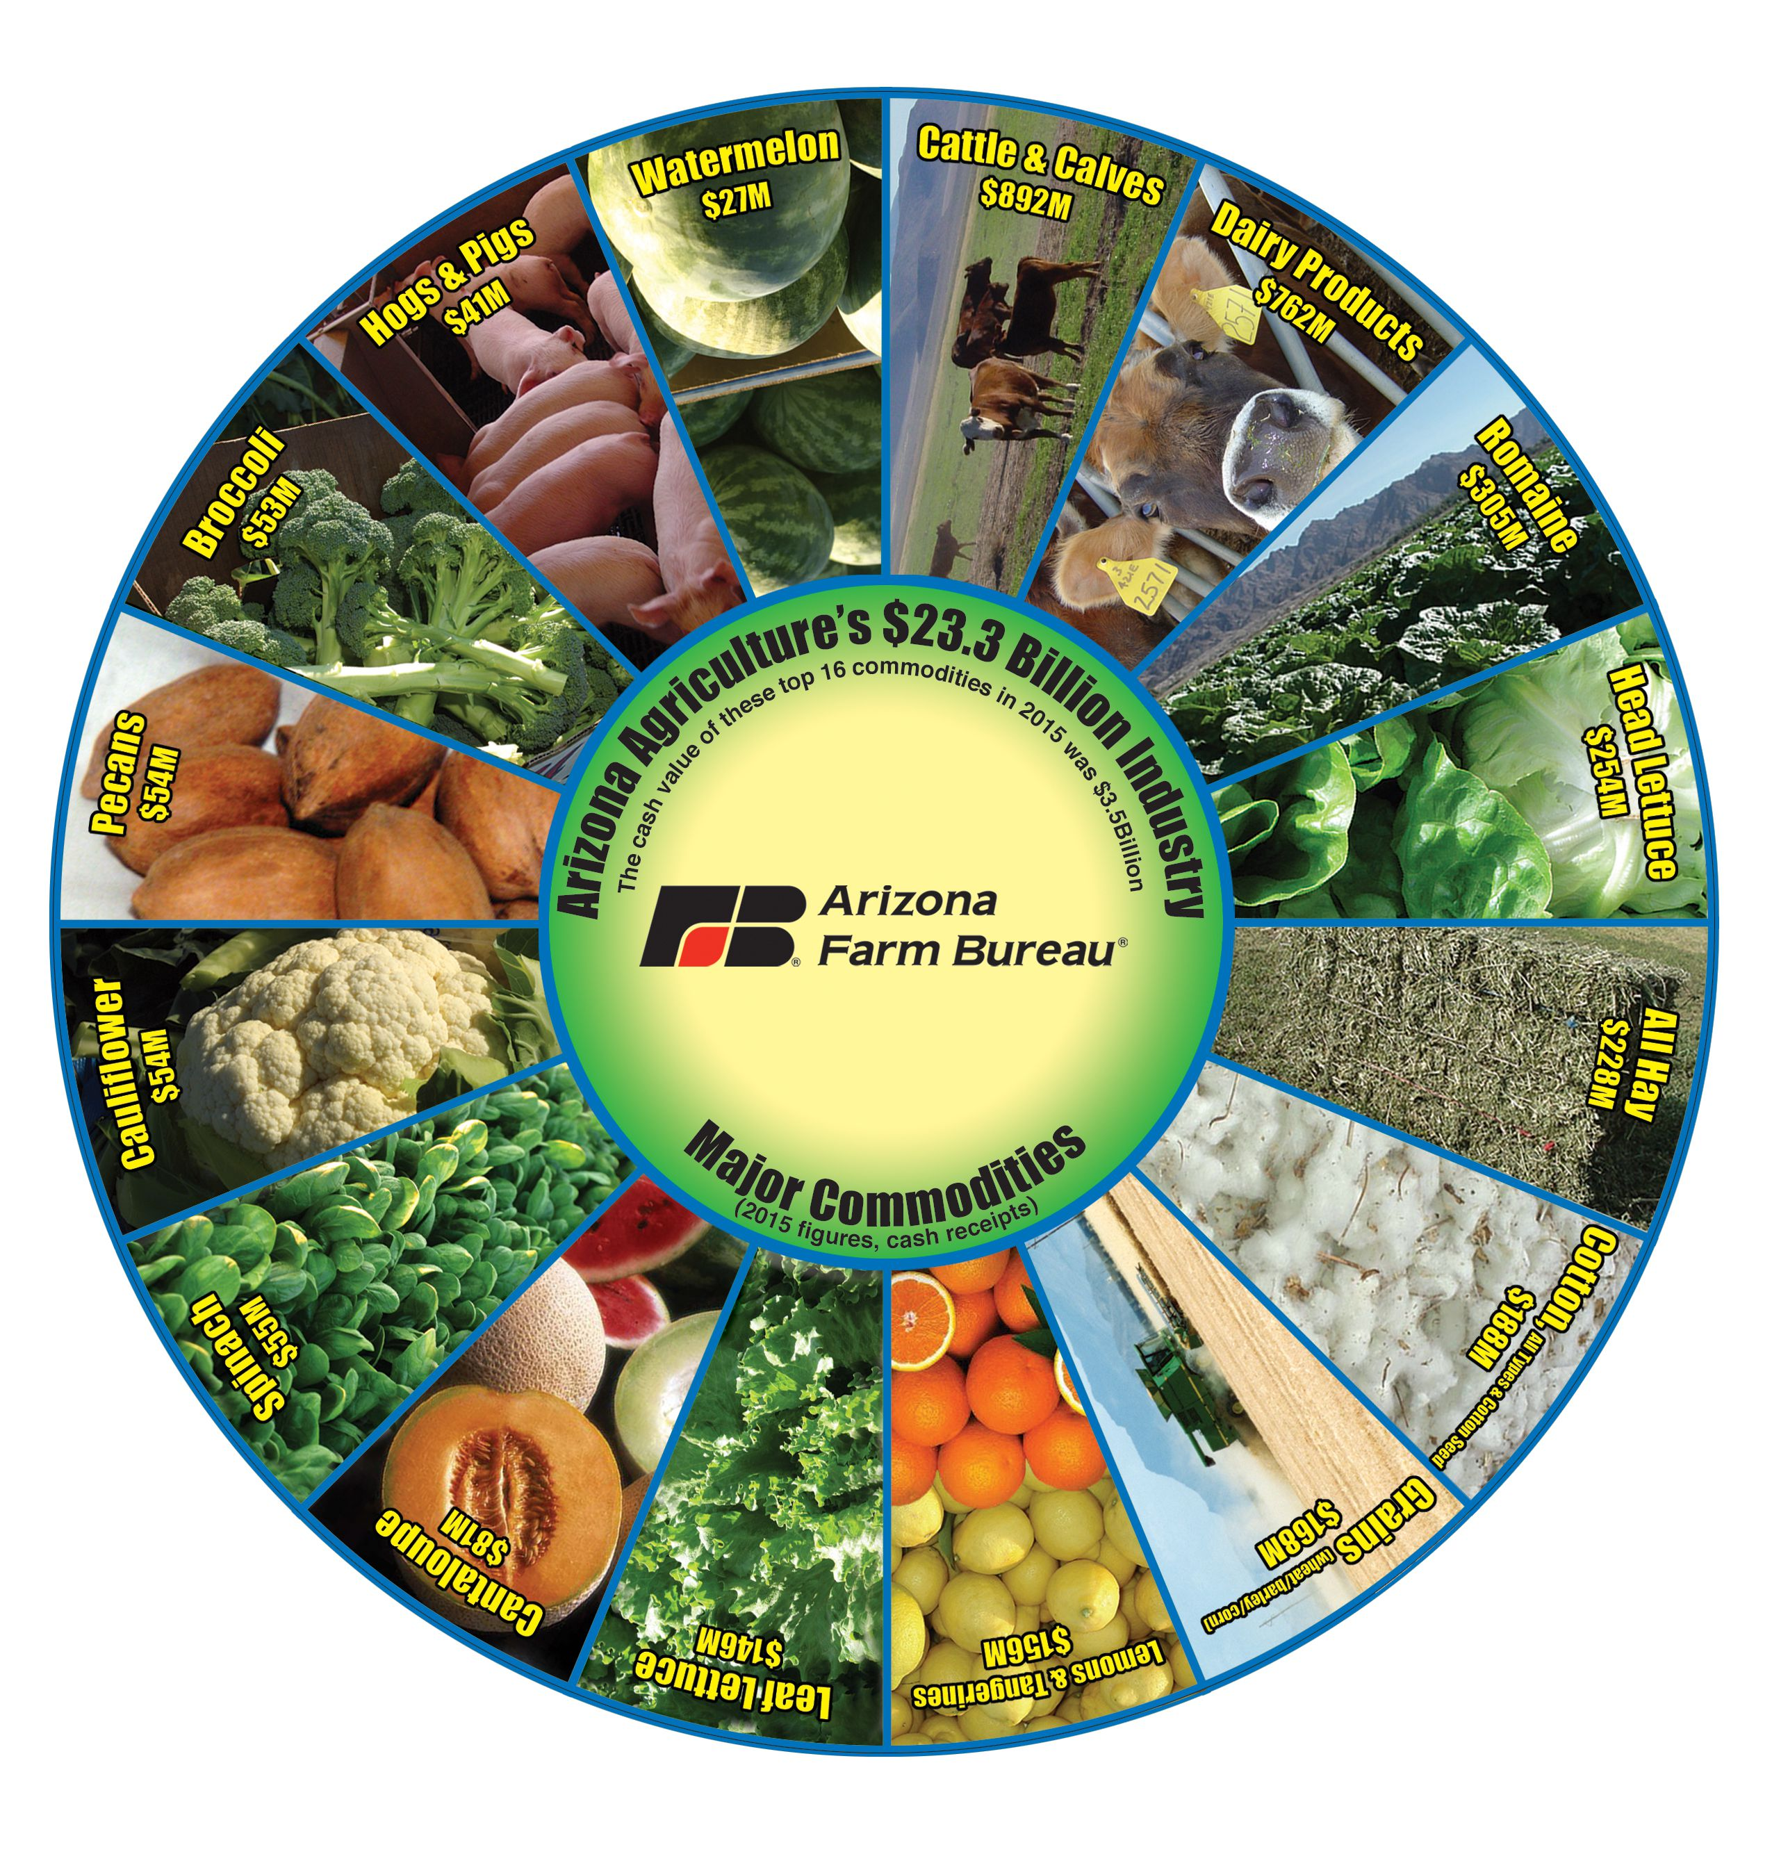
Agriculture contributes
$23.3 billion to the Arizona economy, according to a 2017 study by University of Arizona economists

Slide 7
The Importance of Agriculture to AZ
Arizona ranked (2014)
2nd in the nation in vegetable and melon production by weight
3rd by the value of production for vegetables and melons,
3rd by vegetable and melon area harvested
2nd in production of broccoli, cantaloupe, honeydew, spinach, and head, leaf, and Romaine lettuce.
Reference: https://www.azfb.org/Article/New-Arizona-Agriculture-Studies-Show-Move-to-HigherValue-Crops-While-Also-Conserving-Water

Slide 8
Activity: Plan Your Crops, Round 1
Try to maximize your profit.
Use your farm plot grid (each plot is one acre)
You have 20 acres of land
You have to plant at least 2 different crops max 5 different crops
For each plot record
Write (on each square or group of squares)
  Crop type
  Profit per acre
  For guayule use dice to determine $ per acre
CROP TYPE | Profit per acre
Alfalfa | 1,600
Cotton | 1,200
Pecans | 3,000
Garbanzo beans | $50
Corn | $750
Wheat | $700
Sunflowers | $800
Guayule | $ = roll the dice x 750.00
Melons | $5,000

Slide 9
Activity: Plan Your Crops, Round 2
CROP TYPE | Water use score
Alfalfa | 3
Cotton | 4
Pecans | 3
Garbanzo beans | 2
Corn | 4
Wheat | 2
Sunflowers | 2
Melons | 2
Guayule | .5
Now try to plant crops to get the lowest water use score.
You have 20 acres of land
Plant at least 2 different crops and no more than 5 different crops
On each plot record
  Crop type
  Water Use score*
*The higher the number, the more water used per acre.

Slide 10
Record and Share Questions
Individual Crop Layout Analysis
  How do your 2 farms layouts differ?
  What is the profit from round 1? Total
  What crops did you grow? Why?
  What was your water use score in round 2?
Compare your results with your neighbors
  What patterns do you notice?
  What crops are high water use
  What crops create high profits

Slide 11
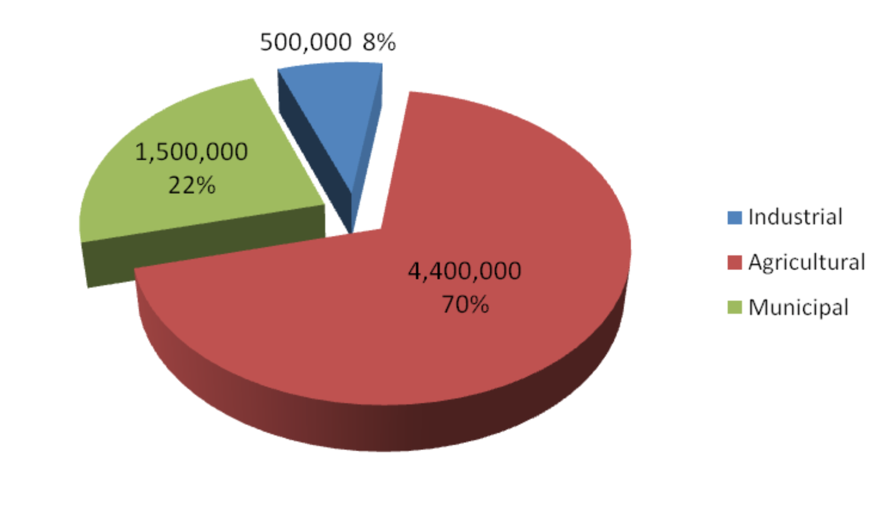
Water use and farming in Arizona
Arizona farmers, pressured by drought and urban growth, look for ways to save water.
https://cronkitenews.azpbs.org/2018/02/09/arizona-farmers-look-for-ways-to-save-water/
Discussion Questions
What information does the pie chart provide to you?
What surprises you?
What might this mean if water supplies decrease?
Water Use In Arizona
Source: Arizona Department of Water Resources
(http://www.azwater.gov)

Slide 12
Can we grow any type of plant anywhere?
No.
Different plants need different growing conditions.
Notes:
(PAPAYA AND COTTON)

Slide 13
Growing conditions in the Sonoran Desert
Abiotic factor
Abiotic factor
Abiotic factor
Abiotic factor
Notes:
Water not very abundant, full sun, basic ph around 7-8.5, Dry climate

Slide 14
Your Ideas About Agriculture in Arizona
Think about the farms you developed in Activity 1
What ideas do you have to reduce water use by agriculture but to maintain or create a economy that keeps people employed in AZ?
What are the qualities of crops/plants we might look for to start growing on our farms?
What are some other considerations that could impact what you choose to plant?

Slide 15
What can we grow in the Sonoran Desert?
Blueberries
Soil pH: 3.5-4.4
Papaya
Soil pH: 5.5-6.5
Guayule
Soil pH: 6.0-8.5
Sun: Full sun
Temperature: 70-90°F
Habitat: Tropical
Sun: Full sun
Temperature: 90-100°F
Habitat: Desert
Sun: Full sun
Temperature: 35-55°F
Habitat: Temperate

Slide 16
What is Guayule?
Watch a short video on Guayule
https://www.youtube.com/watch?v=jwEgHpInBR4
Discuss: Why might Guayule be a good crop to grow in Arizona?

Slide 17
What are your ideas?
Think about the farms you designed.
What ideas do you have to reduce agricultural water use?
What are the qualities or characteristics of crops/plants we might look for Arizona agriculture?

Slide 18
Group Questions
Speed and correctness count!

Slide 19
Question 1: Name five crops that grown in Arizona.
Cotton
Corn
Soybeans
Sunflower
Melons
Guayule
Lettuce
Group | 1 | 2 | 3 | 4 | 5 | 6
Points

Slide 20
Question 2: List 3 abiotic factors that affect the type of plants we can grow in the Sonoran Desert.
Water
Soil
Climate
Temperature
Sunlight
Group | 1 | 2 | 3 | 4 | 5 | 6
Points

Slide 21
Question 3: What is agriculture? (It includes 2 things)
Growing and harvesting crops
Raising animals or livestock
Group | 1 | 2 | 3 | 4 | 5 | 6
Points

Slide 22
Question 4: Which plant is better suited to grow in our desert?
 | Plant A | Plant B | Plant C
Soil pH | 5 | 7 | 7
Sunlight Required | Full Sun | Partly Shaded | Full Sun
Temperature | 70-90°F | 35-55°F | 70-90°F
Water Required | Steady irrigation | Semi-frequent | Semi-frequent
Group | 1 | 2 | 3 | 4 | 5 | 6
Points

Slide 23
Question 5: Why is agriculture important?
Agriculture affects all of our lives:
  The food we eat
  The clothes we wear
  The paper we write on
  The air we breathe
  Etc.
Group | 1 | 2 | 3 | 4 | 5 | 6
Points

Slide 24
Any questions?

