Slide 1
Biotic Resilience in the Desert
Matt Swanson, Nick Morris, Juan Arias, Nathan Notah
University of Arizona Cooperative Extension

Slide 2
Biotic Resilience in the Desert
Question: Biotic (living) organisms in an ecosystem demonstrate resilience by adapting to changing conditions. Can you think of an example?
Definitions
Resilience: the capacity to recover quickly from difficulties and challenges.
Adaptation: The process of change by which an organism or species becomes better suited to its environment.
Biotic: The living parts of an ecosystem

Slide 3
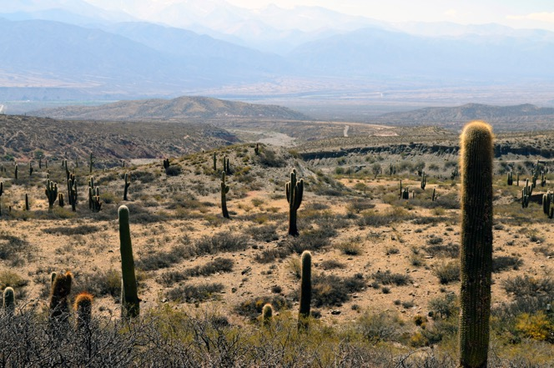
Objective: In this activity, you will define resilience in an ecosystem and use examples to create a list of strategies, many of which have long been practices of Native American communities, for how humans can adapt to arid (desert) ecosystems.

Slide 4
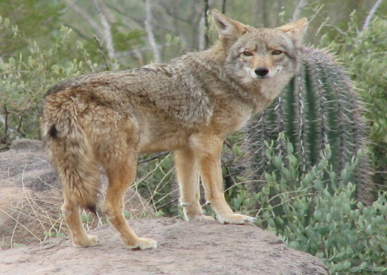
What are examples of biotic resilience in arid lands?
    Coyote/ Ma'ii / Iisawu / Ma’ (Spanish/Navajo/Hopi/Apache)
                Moves across large areas of habitats to find water and food.
            Adapt their food source and strategies based on the resources that are available in a habitat.
            Can hunt small prey alone or team up to hunt in packs for larger prey.

Slide 5
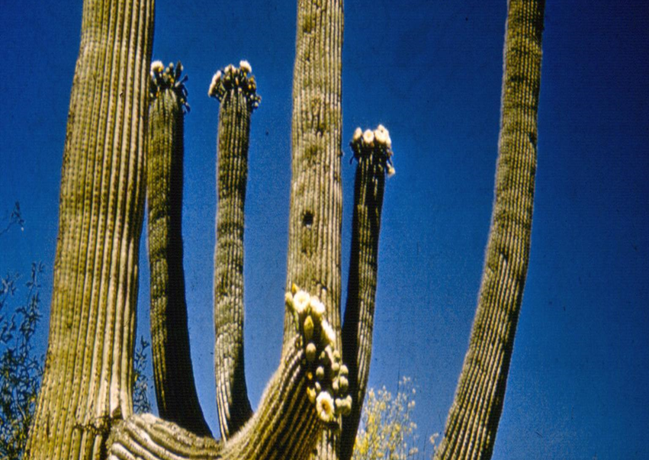
What are examples of biotic resilience in arid lands?
Hashan/Hoshtsoh/Hosh/Saguaro
(Tohono O'odam/Navajo/Apache/Spanish)
Spines protect plant from possible predators.
Spines provides shade in the summer and minimizes water loss from dry winds.
Covered in thick waxy coating to prevent moisture loss.
Root systems maximize water collected.
Uses very little water day to day so excess water can be stored for long periods of time to be used in drought.

Slide 6
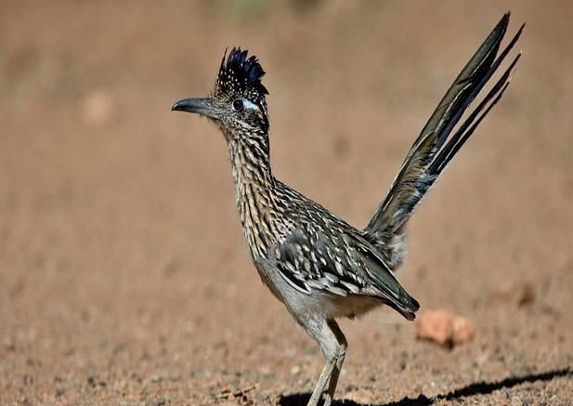
What are examples of biotic resilience in arid lands?
Tadai /Naatsédlózii / góshdiyé /Correcaminos / Roadrunner
(Akimel O'odham/Navajo/Apache/Spanish/English)
Secretes highly concentrated salt from a tear duct to save water.
Obtain water mostly from absorbing it from prey.
Have high endurance and can travel fast without using much water.

Slide 7
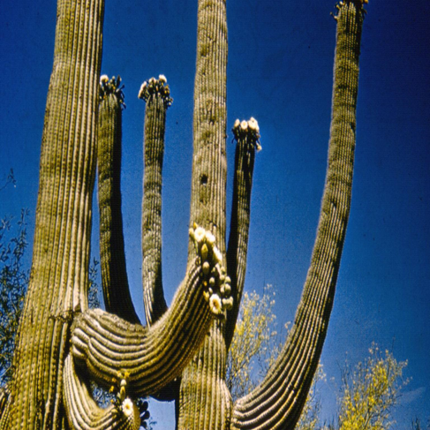
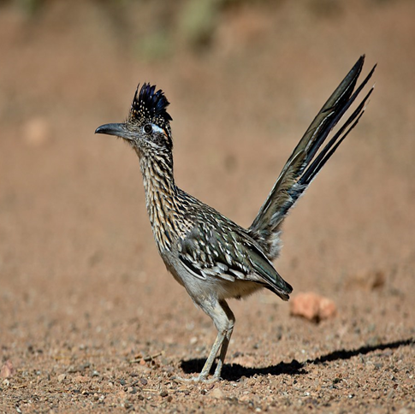
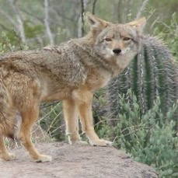
Question: What is the main challenge that all these organisms face in a desert ecosystem?

Slide 8
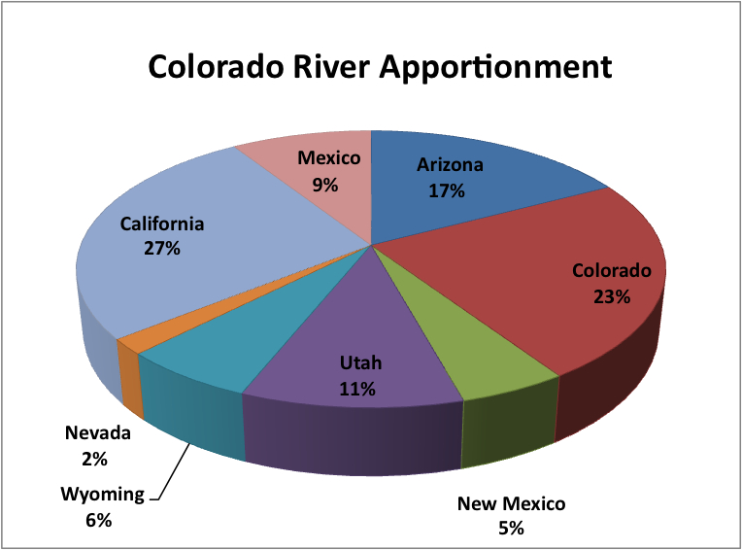
Human Land Use in Desert Regions
Currently, human activities in desert ecosystems have the same major challenge as many other members of the ecosystem: water availability.
Lots of human systems in arid lands depend on large scale diversion of water from where it naturally occurs.
Question: How do you use water?
How does your city or town use water?
Optional: Straws in the Colorado River: Will We Run Out of Water? https://serc.carleton.edu/trex/students/labs/lab4_1.html

Slide 9
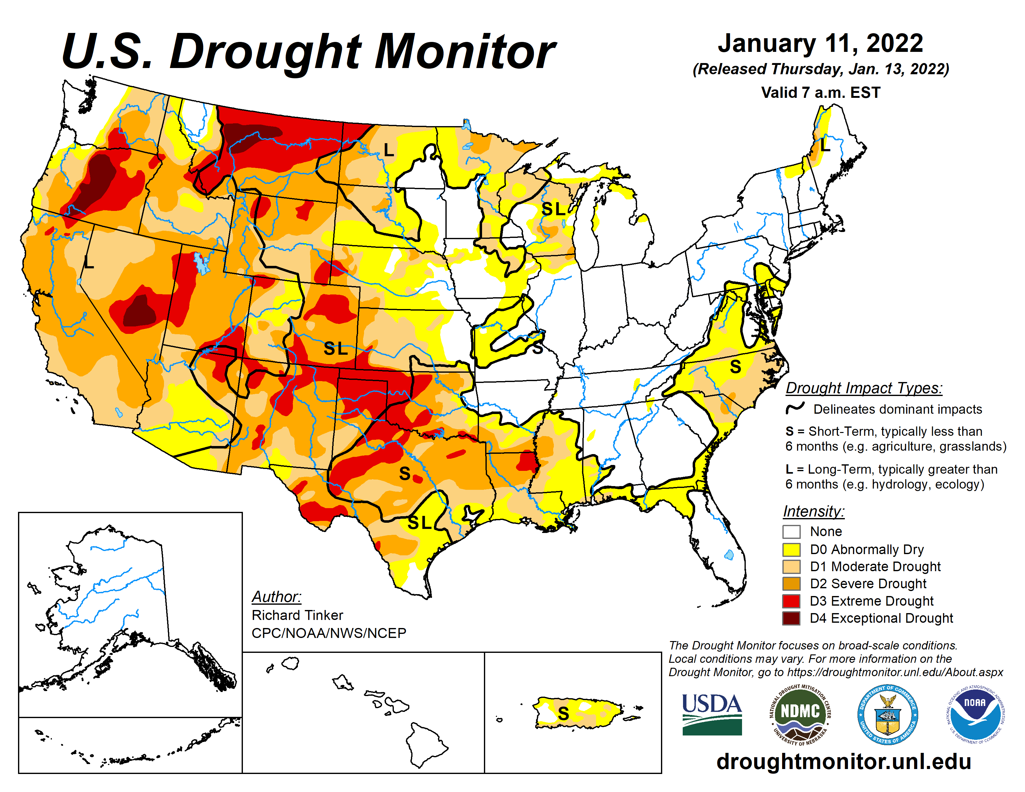
Drought is threatening human land use in arid lands
Recent Southwestern Drought the Worst in 1,200 Years
City of Phoenix Drought Restrictions and Information Hub

Slide 10
Can we learn from the resilience of other members of the desert ecosystem?
Movement and Innovation
Examples: technology, migration, finding new sources
How can humans learn from the Coyote's adaptations?
Coyote/ Ma'ii / IIsawu – movement and innovation
Notes:
Maybe reorganize this slide

Slide 11
Can we learn from the resilience of other members of the desert ecosystem?
Capturing and Storage
Examples: holding on to water, storing more where it is needed
How can humans learn from the Saguaro's adaptations?
Saguaro/Hashan/Hoshtsoh - capturing and storage
Roadrunner/ Tadai/Naatsédlózii - efficiency and reuse
Notes:
Maybe reorganize this slide

Slide 12
Can we learn from the resilience of other members of the desert ecosystem?
Efficiency and Reuse
Examples: Using less, recycling
How can humans learn from the Roadrunner's adaptations?
Roadrunner/ Tadai/Naatsédlózii - efficiency and reuse
Notes:
Maybe reorganize this slide

Slide 13


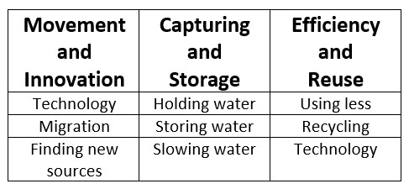
Can we learn from the resilience of other members of the desert ecosystem?
Coyote/ Ma'ii / IIsawu – movement and innovation
Saguaro/Hashan/Hoshtsoh - capturing and storage
Roadrunner/ Tadai/Naatsédlózii - efficiency and reuse

Slide 14
Activity: Resilience Brainstorm
Use a piece of paper to create a simple chart with 3 columns.
Label the columns: Movement and Innovation, Capturing and Storage, and Efficiency and Reuse
List any actions humans in arid lands may be able to take that are related to that category.
When your teachers calls time, add up the number of ideas you had for each column and put that number at the top of the column.

Slide 15
Activity: Resilience Strategy Card Sort
Use a piece of paper to create a simple chart with 3 columns.
Label the columns: Movement and Innovation, Capturing and Storage, and Efficiency and Reuse
Pick the Resilience Cards from the container and sort into the columns where they best fit. Some cards work in multiple columns.
When your teacher calls time, add up the number of ideas you had for each column and put that number at the top of the column.

Slide 16
Wrap Up Questions
1. What are two examples of strategies that involved modern technology?
2. What are two examples of strategies involving a practice that may have already been used for a long time?
3. What strategies would be difficult to get people to try?
4. What strategies would be easier to convince people to try?

Slide 17
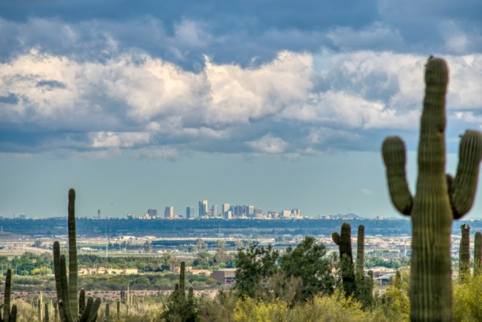
Exit Ticket
Pick a strategy card. Imagine it is adopted by a large group of humans in an arid environment. How would you know it is working?

Slide 18


Author Biography and Acknowledgment
Matt Swanson is a lifelong Arizona resident and an educator with experience teaching science at the middle school and high school levels. He is now working for the Arizona State 4-H office as a Curriculum Specialist, where he continues to enjoy bringing learning experience to youth. He received both his undergraduate degree in philosophy and his graduate degree in science education at the University of Arizona.
Thank you to Juan Arias and the other members of the White Mountain Apache community who reviewed this lesson for their invaluable feedback.
Thank you to Nick Morris, Nathan Notah and Juan Arias for developing the initial idea for the biotic resilience lesson.
Sustainable Bioeconomies for Arid Regions Center of Excellence: https://sbar.arizona.edu
Any opinions, findings, conclusions, or recommendations expressed in this PowerPoint lesson are those of the author(s) and do not necessarily reflect the view of the U.S. Department of Agriculture. Grant # 2017-68005-26867.

