Slide 1
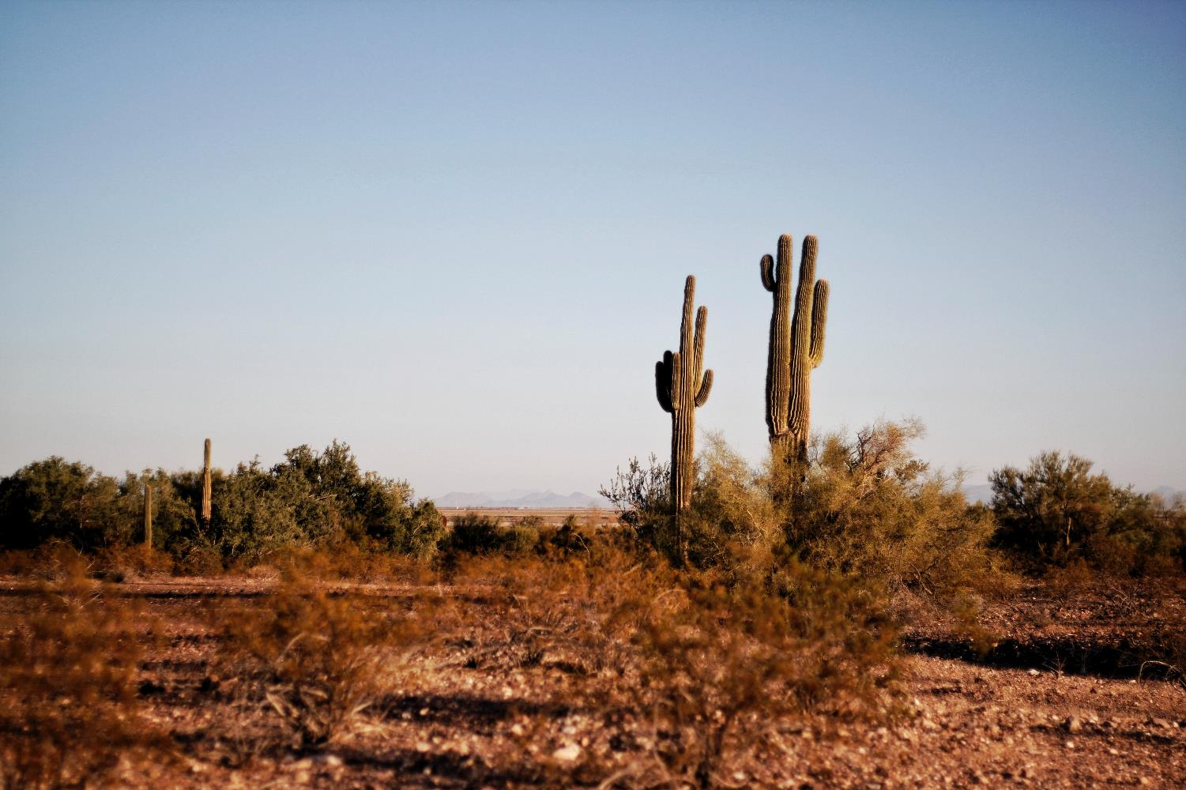

Deserts: Definition and Causes
Traci Klein and Matthew Katterman
University of Arizona

Slide 2
Think, Pair, Share
What is a desert?
What are deserts like?
How much rain do deserts get?
What is the weather like in a desert?
How many plants are there in the desert?
Students free write on this topic
What are some things that make it difficult to live in deserts both for humans and other species?
Notes:
Think, pair, share.

Slide 3
Definition:
Desert - a region so arid (dry) because of little rainfall that it supports only sparse and widely spaced vegetation or no vegetation at all
-dictionary.com
Generally less than 25 cm (10 inches) of rain annually

Slide 4
Discuss
What are the names some deserts you have heard of?
Notes:
Popcorn out.

Slide 5
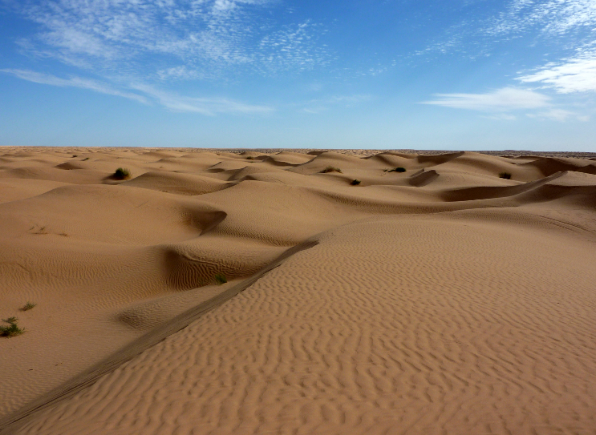
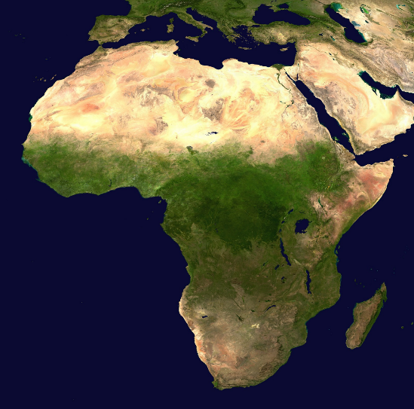
Sahara Desert
Notes:
https://commons.wikimedia.org/wiki/File:Sahara_3.jpg
https://commons.wikimedia.org/wiki/File:Africa_satellite_orthographic.jpg

Slide 6
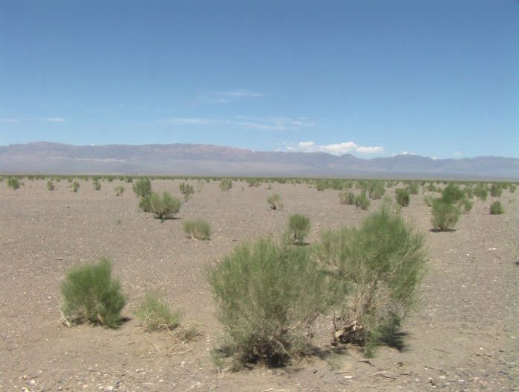
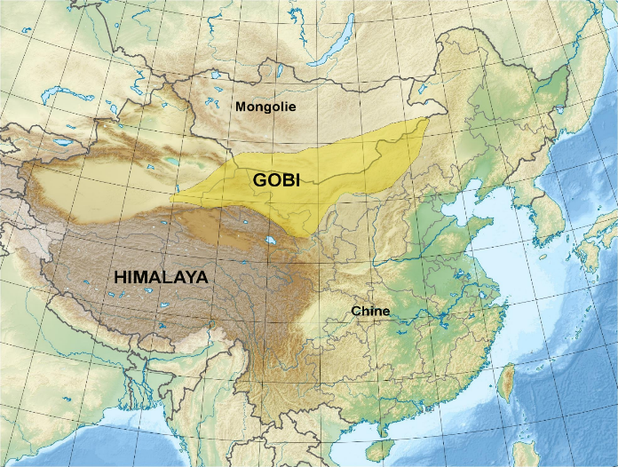
Gobi Desert
Notes:
https://commons.wikimedia.org/wiki/File:Saxaul_in_Gobi_desert.JPG
https://commons.wikimedia.org/wiki/File:Gobi_desert_fr.jpg

Slide 7
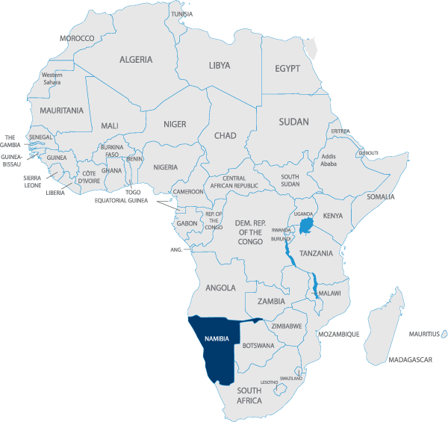
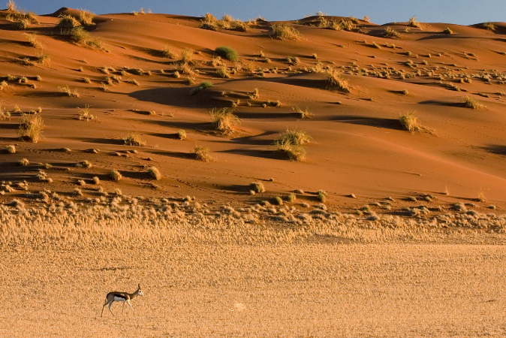
Namib Desert
Notes:
https://commons.wikimedia.org/wiki/File:Springbok_Antelope_Sossusvlei_Namib_Desert_Namibia_Luca_Galuzzi_2004.JPG
http://biofocuscommunicatie.nl/nabimi-africa-map/

Slide 8
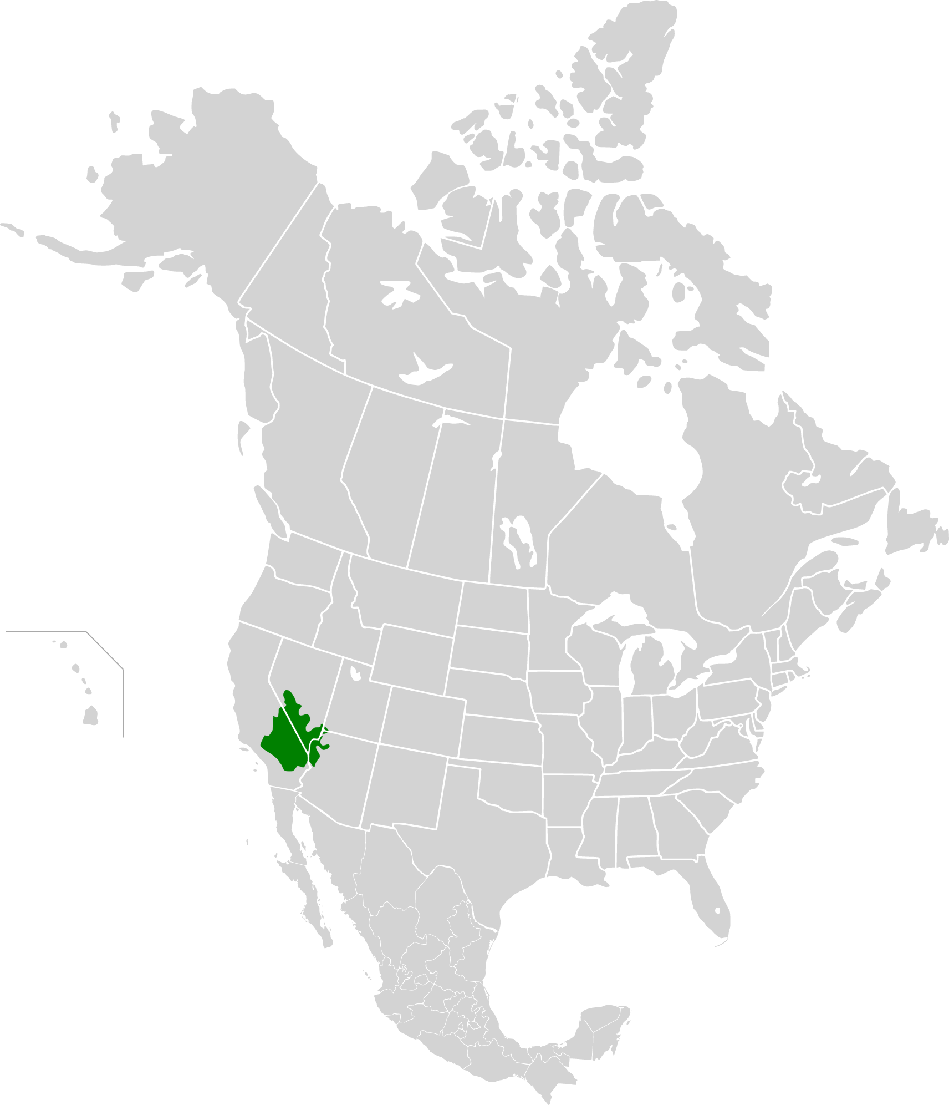
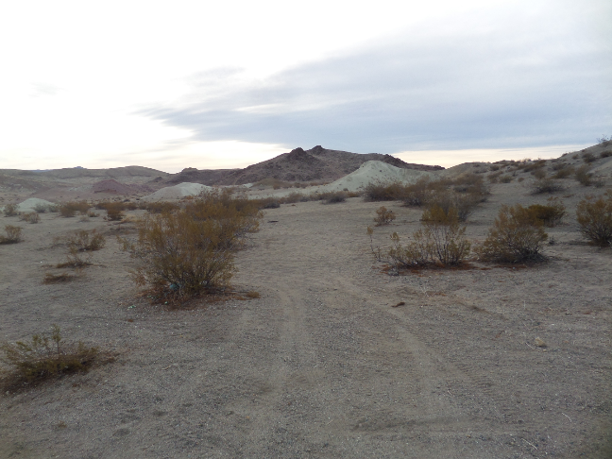
Mojave Desert
Notes:
https://commons.wikimedia.org/wiki/File:Searles,_CA_Mojave_Desert.jpg
https://commons.wikimedia.org/wiki/File:Mojave_Desert_map.svg

Slide 9
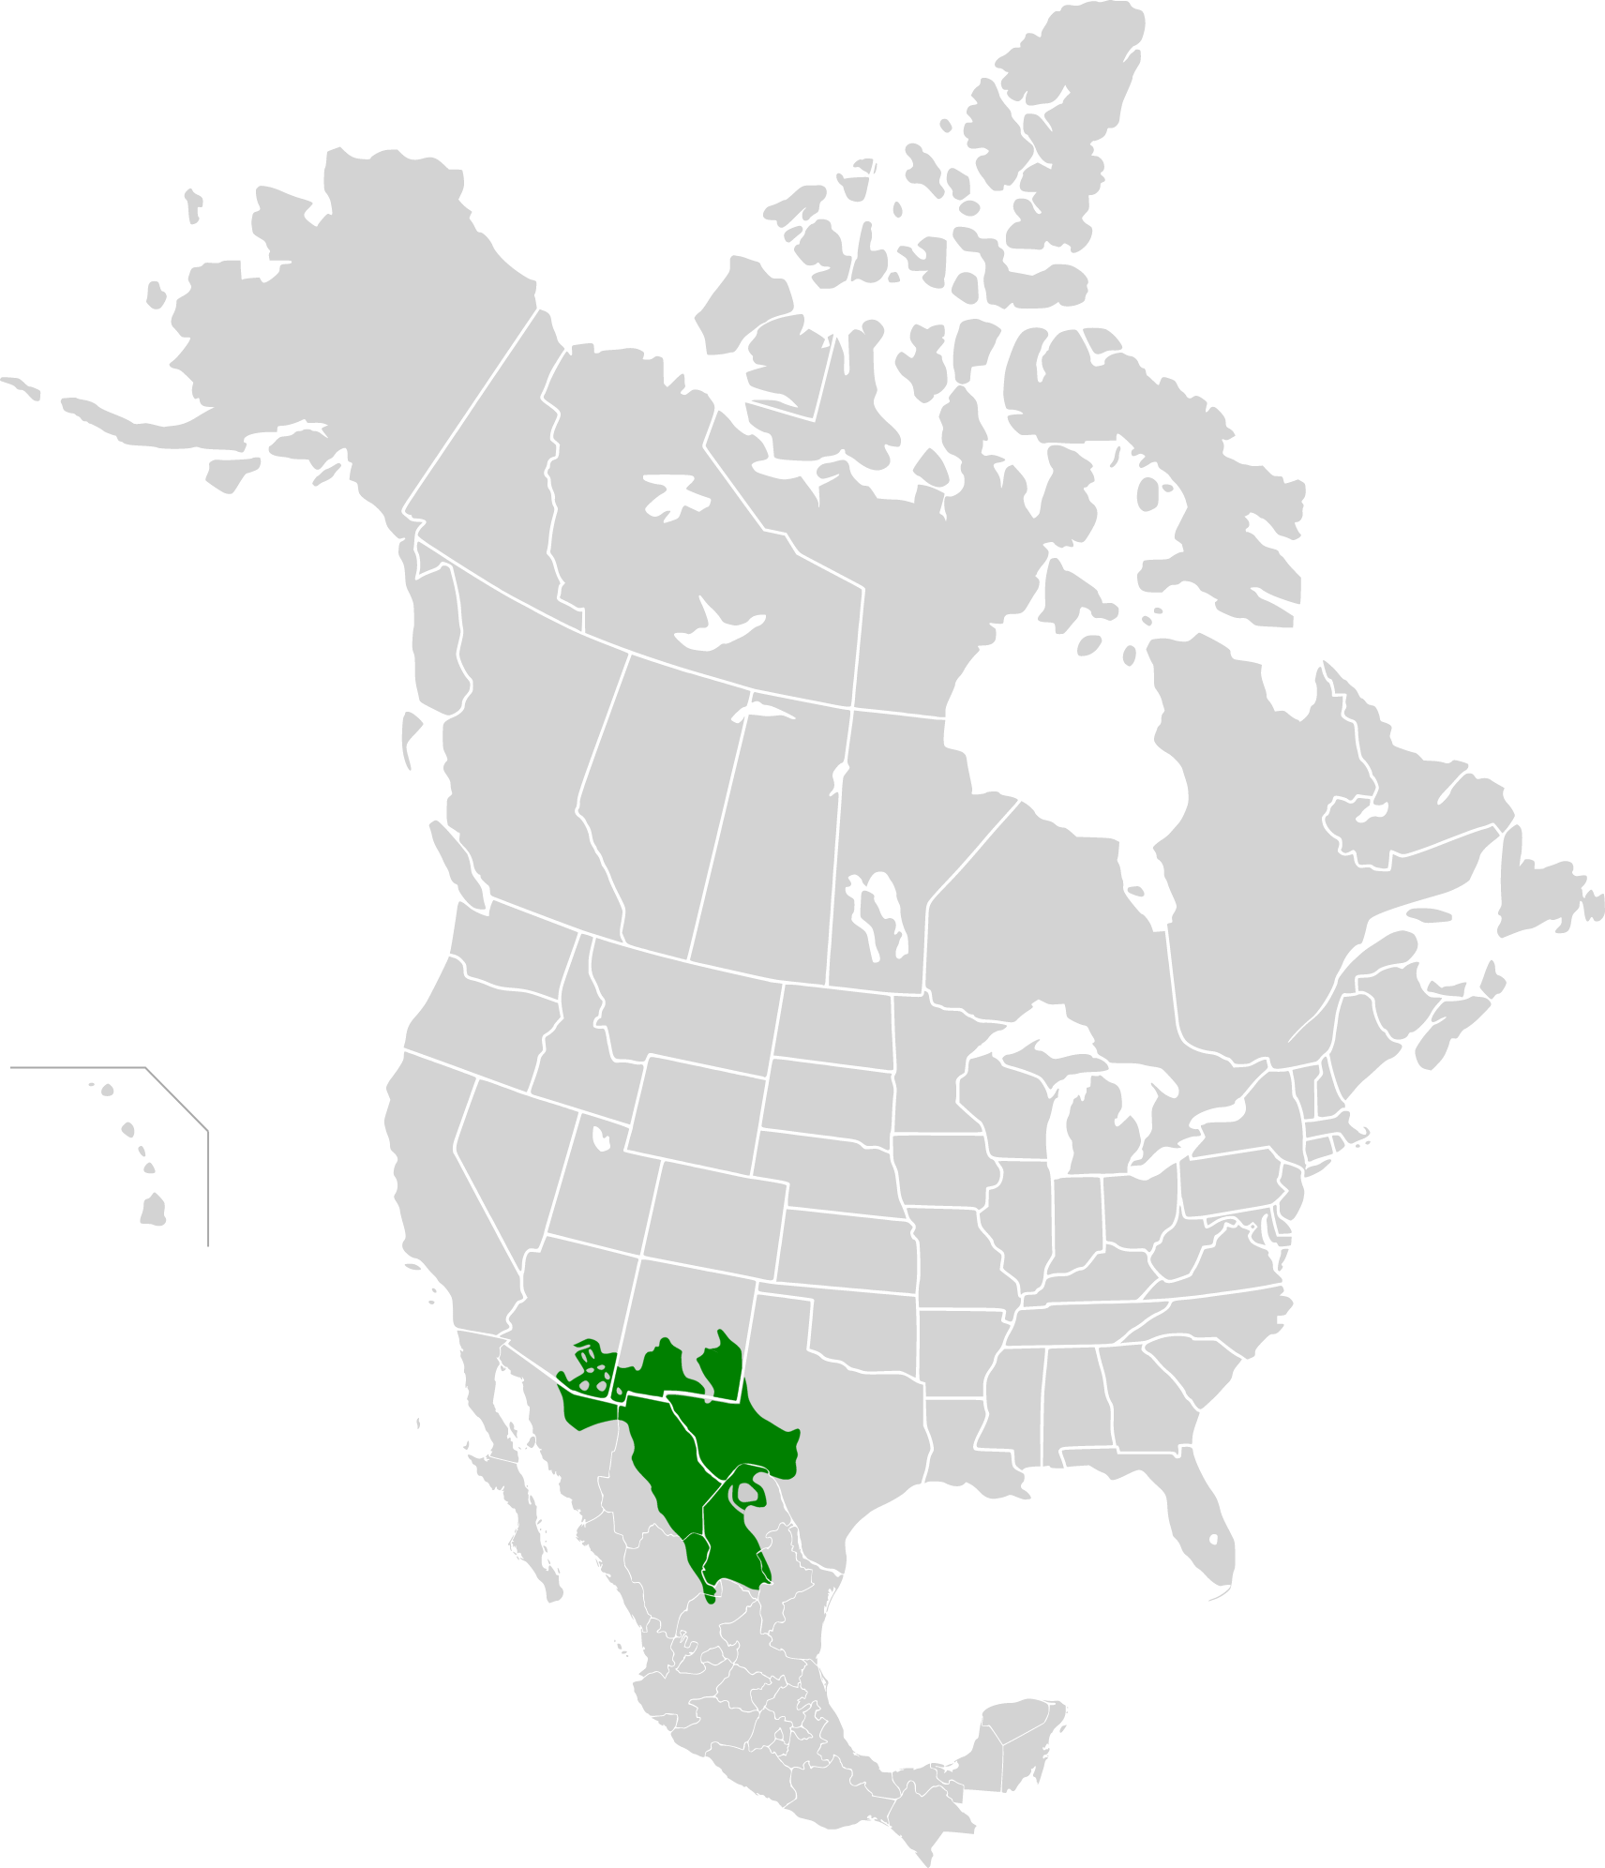
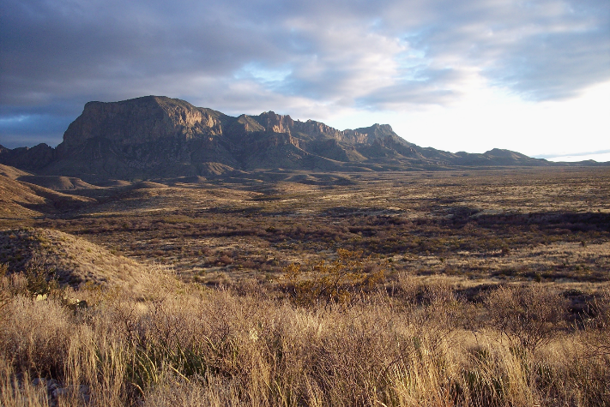
Chihuahuan Desert
Notes:
https://commons.wikimedia.org/wiki/File:Big_Bend_Chihuahuan_Desert.jpg
https://commons.wikimedia.org/wiki/File:Chihuahuan_Desert_map.svg

Slide 10
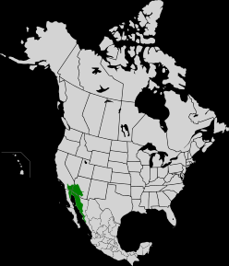
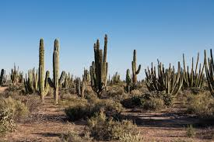
Sonoran Desert
Notes:
https://commons.wikimedia.org/wiki/File:Sonoran_desert_at_Bahia_Kino.jpg
https://en.wikipedia.org/wiki/Sonoran_Desert#/media/File:Sonoran_Desert_map.svg

Slide 11
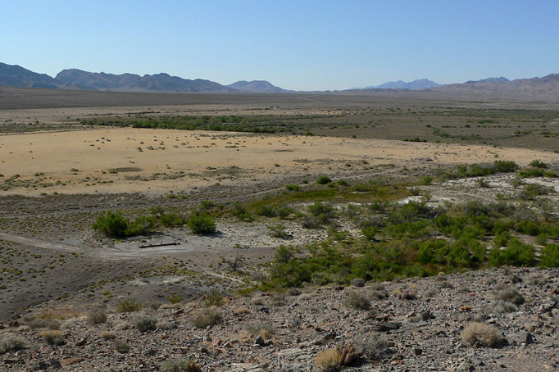
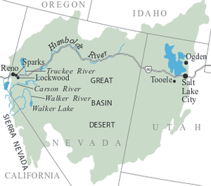
Great Basin Desert
Notes:
https://en.wikipedia.org/wiki/Great_Basin_Desert

Slide 12
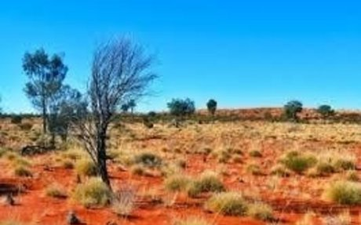
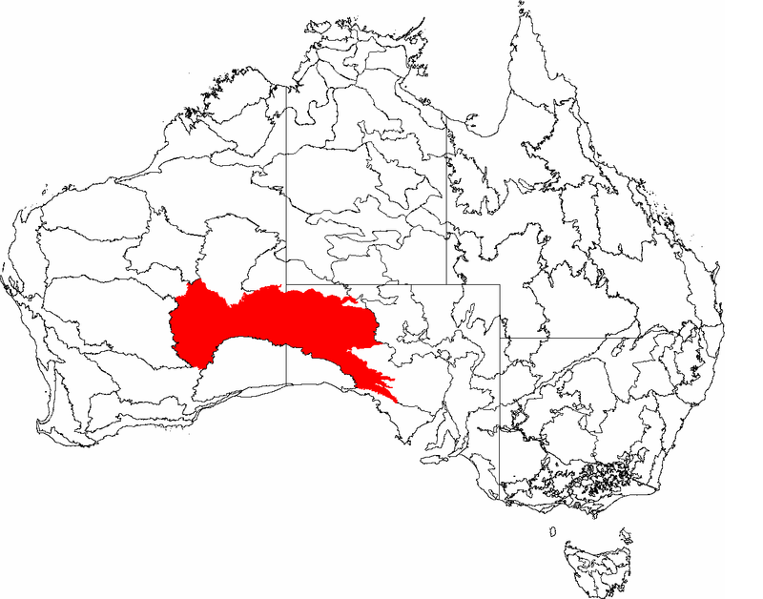
Great Victoria Desert
Notes:
https://en.wikipedia.org/wiki/Great_Victoria_Desert

Slide 13
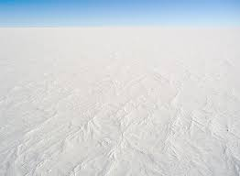
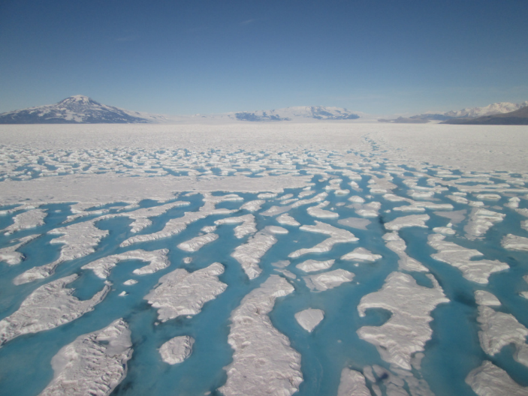
Polar Deserts: Antarctic Polar Desert and Arctic Polar Desert
Notes:
Antartic polar desert: https://source.colostate.edu/short-lived-glacial-melts-can-cause-alterations-in-polar-regions/
See ARC GIS Storymaps on Artic Deserts: https://storymaps.arcgis.com/stories/b9fc57f5d64c4d888bef4dcd2c875675
“Deserts. When most people think of this word, they think of a humid, sandy and limited vegetation. Whilst desert vegetation is limited, it isn’t always hot and dry. Polar Deserts is a kind of desert where it is cold instead of hot and its surface is ice, not sand. This biome is located in many places around our world. They “are characterized by cold winters with snowfall and high overall rainfall throughout the winter and occasionally over the summer. They occur in the Antarctic, Greenland and the Nearctic realm.” (Garcia, 2019). The second-largest desert in the world is the Arctic, as it’s the area is “14.056 million sq. km” (FactMonster, 2019). Making up most, if not all, of Antarctica’s’ biomes and surface. “

Slide 14
Think, Pair, Share
What issues do we face living in a desert?
Notes:
Think, pair, share. Potential answers: being able to grow enough food; hard to grow plants because of water and weather; venomous animals such as scorpions, snakes, etc.; very hot and bright; being able to stay cool enough; dust storms (Previously in the these notes: Water, dust, growing food, heat, strong light.)

Slide 15
Discuss
What do we most need to worry about to make sure we are living sustainably in the desert?
Sustainable - (adjective) able to be maintained or kept going, as an action or process
Notes:
Water!
This is a good stopping point between lesson days.

Slide 16
Think, Pair, Share
What causes a desert?
Why are some places on the planet wet and others dry?
Notes:
Think, pair, share. Entertain all ideas.
a. What causes a desert? Some possible answers that could guide student sharing include mentioning that not enough water or rainfall in the area may cause a desert. A desert may contain a high air pressure area and high-pressure areas are associated with dry, warm and settled weather conditions. This is because sinking air does not result in precipitation.
b. Why are some places on the planet wet and others are dry? The teacher could encourage the students to come up with answers that include one or a combination of factors that include wind, ocean currents and high and low air pressure areas that determine where rainfall occurs. The idea that the terrain is different in some areas such as high mountains, plains, etc., makes it easier for certain locations to get rain.

Slide 17
Explore Cause #1 for Deserts: Rain Shadows
Definition:
Rain shadow – (noun) A region having little rainfall because it is sheltered from prevailing rain-bearing winds by a range of hills.
Watch Video: Rain Shadow Effect: 2 Minute Geology https://www.youtube.com/watch?v=DoKTTHd-XEQ
Demonstrate a rain shadow.
Draw and diagram the rain shadow process.
Notes:
Students should copy diagram into notes. Use a sponge to illustrate the diagram. It fills with water on the ocean side, then rises and cools so becomes more dense and the water is squeezed out.
a. Define rain shadow: A patch of land that has been forced to become a desert because mountain ranges blocked all plant growth and rainy weather.
b. Watch the 2-3 minute video on rain shadows called Rain Shadow Effect: 2 minute Geology. https://www.youtube.com/watch?v=DoKTTHd-XEQ
c. Demonstration: Using a sponge, a bucket of water, and a model for a mountain, plunge the sponge in a filled bucket of water. Comment that the sponge is a cloud and as it rises it gets denser until it cannot hold the water and then it rains. Squeeze the sponge. As the cloud goes up and over the “mountain”, all the moisture is removed from it so it is dry and no longer rains on the other side.
d. Have students draw (copy) the diagram of a mountain and land on both sides. Go through the steps of the clouds raining and then disappearing when going over the mountain. Have them draw the diagram at each step as seen on the screen (from shots in the video).
Further definition on Rain Shadows: Rain Shadow Effect - an area having relatively little precipitation due to the effect of a topographic barrier, especially a mountain range, that causes the prevailing winds to lose their moisture on the windward side, causing the leeward side to be dry.) Then it is important to note that it is the availability of moisture that allows plants to grow (not the mountains). When little rainfall happens, plants must adapt to survive under the dry conditions and they all have varying ways of coping with the heat/dry periods. (Which can be a whole other lesson!)

Slide 18
Explore Cause #2 for Deserts: Hadley Cells
Definition:
Hadley cell – (noun) a pattern of atmospheric circulation in which warm air rises near the equator, cools as it travels poleward at high altitude, sinks as cold air and warms as it travels towards the equator again
Watch Video: Why Does Earth Have Deserts? From MinuteEarth. https://www.youtube.com/watch?v=T6Us1sPXBfA
Notes:
Play video at 1.5 speed
Let students watch the video all the way through. They will be confused. Next slides and the experiment will help them understand in more depth, so don’t panic!

Slide 19
Definition:
DENSITY – (noun)
1. the amount of mass in a given volume (or how much stuff fits in a given space)
2. the state of being slow to understand.
Synonyms: heaviness, consistency, thickness
The adjective form is “dense”
- dictionary.com
Notes:
The definition of density is a good one to have up in the room for ready reference.

Slide 20
Examples of Density:
The density of the rock made it sink under water.
The student’s density made him confused.
Oil is less dense than water, so it floats on top.
Helium is less dense than regular air, so helium balloons float upwards.

Slide 21
Temperature and Density
Temperature changes density.
When you heat something, the molecules it is made of start moving faster. This can cause them to bounce off each other and begin spreading apart. The hotter something is, the more space there is between the molecules. You have less “stuff” in the same space.
So, as heat goes up, density goes down. As heat goes down, density goes up.
Notes:
It is helpful to move your hands in opposite directions and have students do the same to remember the relationship between heat and density.

Slide 22
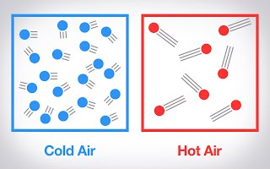
Temperature and Density
More dense
Less dense
Notes:
https://sites.google.com/a/voorheesville.org/web-activities/home/g-6---hot-air-balloon-project/scientist---heat-and-density

Slide 23
Understanding Hadley Cells
Draw a Hadley cell with information from the video:
Why Does Earth Have Deserts? From MinuteEarth. https://www.youtube.com/watch?v=T6Us1sPXBfA
Stop at 1:19
Draw the diagram shown in the video.
Discuss: What heats the air at the equator?
Does it become more or less dense?
Which direction does it move?

Slide 24
Understanding Hadley Cells
Stop at 1:33
Draw rain clouds above the rising hot air in the diagram.
Discuss:
Why does the air cool as it goes up?
As it cools, does it get more or less dense?
What happens to the space between air molecules?
What does this do to the water between the air molecules?
Notes:
Remind students of the sponge squeezing out water from the rain shadow example.
As it cools, does it get more or less dense? What happens to the space between air molecules? What does this do to the water between the air molecules? Remind the students of the sponge squeezing out water from the rain shadow as an example to help answer the questions.

Slide 25
Understanding Hadley Cells
Stop at 1:43
Draw “ceiling” in diagram and show the air moving sideways.
Discuss:
Why does the air stop going up?
Where can it go?

Slide 26
Understanding Hadley Cells
Stop at 1:53
Draw sinking, dry air, wind lines, and desert below the Hadley cell.
Discuss:
What happens to the temperature of the air as it moves sideways at high altitude?
Is cold air more or less dense?
What happens to dense air?
Does this cold air have much water in it?
Draw: complete the circle on the diagrams. This is a Hadley Cell.
Notes:
Complete the drawing by having the air move back to the equator from both the north and south deserts with the appropriate wind lines and arrows. Tell them this wind pattern cycle is the Hadley cell, which helps form the deserts and rain forests of the world.
After this, do the Hot vs Cold Air experiment.

Slide 27


Traci Klein grew up mostly in Massachusetts, then came west to go to Brigham Young University. She graduated with a BA in Comparative Literature in 1993. After a stint in Salt Lake City while her first husband went to medical school and their two boys were born, they moved to Tucson. Traci decided to switch fields and did graduate work in Plant Sciences at the University of Arizona and worked as a lab researcher for several years. After taking time at home to raise her sons, and after a divorce, she decided to dip her toes into education and began working as a long term substitute in the Baboquivari School District on the Tohono O’odham nation while taking online education classes. She received her teaching certificate and has been teaching 7th grade science at Valencia Middle School for 6 years. She has also been the MESA (Math Engineering Science Achievement) Club Advisor for 5 years. Currently, she is enrolled in the Masters in Educational Leadership program at Northern Arizona University and hopes to go into education administration.
Matthew Katterman is a PHD graduate student at the University of Arizona studying Biosystems Engineering. He is interested in irrigation engineering along with computer modeling of the guayule production system. He also has an intense interest in bioproducts and biofuels production. Matthew is a native of Tucson, Arizona, and received his Bachelor’s in Chemistry in 1997 as well as his Masters in Agricultural and Biosystems Engineering in 2004.
Any opinions, findings, conclusions, or recommendations expressed in this PowerPoint lesson are those of the author(s) and do not necessarily reflect the view of the U.S. Department of Agriculture. Grant # 2017-68005-26867.

