Slide 1
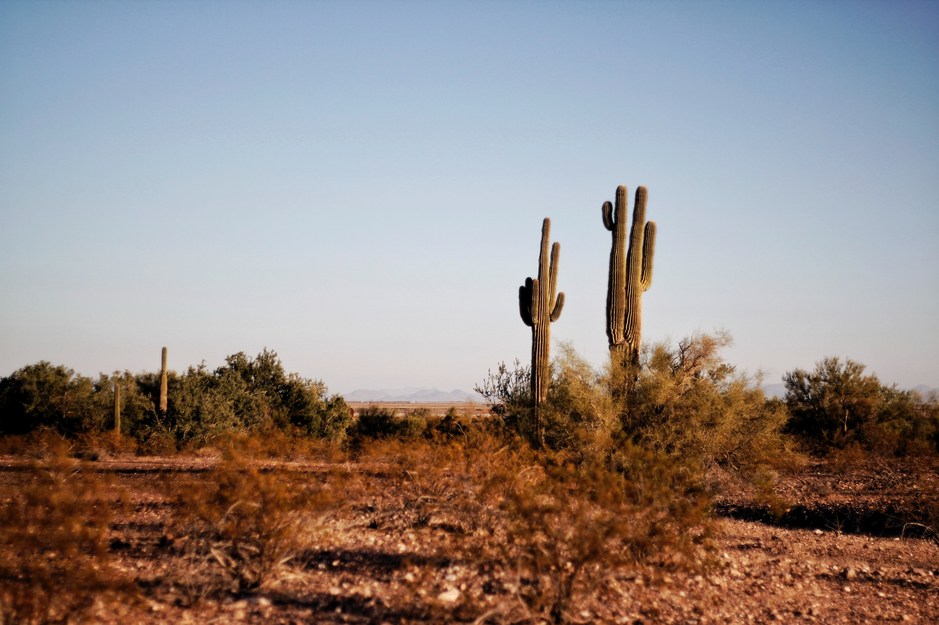
Hot vs. Cold Air : Density Traci Klein and Matthew Katterman University of Arizona

Slide 2
Observation
Answer the following: Describe what you have seen of hot air balloons.

Slide 3
Question
What happens to air when you heat it up?

Slide 4
Background Research
Air is made of little pieces (too small to see, even under a microscope) called molecules. These molecules include oxygen, nitrogen and carbon dioxide, among other things.

Slide 5
Background Research
Density: how heavy an object is for a given volume.
If you hold the same size piece of rock and sponge, which will be heavier? There are a lot of holes in the sponge, so there is less stuff in the same space, and it is lighter (less dense).

Slide 6
Background Research
Why does a rock sink in water? Because it is more dense.
Cold air is more dense than hot air and so cold air sinks and shrinks while hot air rises and expands. In hot air, the molecules are more spread out, like the stuff in a sponge.

Slide 7
Investigating Density
Hypothesis:
If we take a bottle of cold air covered with a balloon and put it into a hot water bath, then the balloon will (inflate / deflate).
Inflate: get bigger
Deflate: get smaller

Slide 8
Materials
Empty water bottle
Balloon
Water
Beaker
Hot plate
Ice

Slide 9
Procedure
Make sure a beaker 1/2 filled with water is on the hot plate.
Turn on the hot plate and wait for the water to boil.
Turn off the hot plate.
Take a water bottle and put a balloon over the top.
Place the bottle just into the hot water and hold it there.
Record what happens to the balloon.
Put the bottle in an ice bath and record what happens to the balloon.

Slide 10
Safety Concerns
Wear goggles because we are working with heat and glass.
Tie back long hair.
Never touch the glass beaker or the top of the hot plate. They are VERY hot!

Slide 11
Conduct the Experiment & Collect Data
Draw pictures of the balloon before it is in the hot water (at room temperature), while it is in the hot water, and while it is in the ice bath.

Slide 12
Data Collection:
At Room Temperature In hot water In ice bath
Notes:
Students should draw what is happening to the balloon at the beginning, what it looks like in hot water, and what it looks like in ice water. They should draw out three boxes in their lab notebook for each of the drawing steps.

Slide 13
Analysis:
What did the balloon do in hot water?
What did the balloon do in cold water?
Why do you think the balloon inflated in hot water?

Slide 14
Conclusion: Record in Student Notebook
What happens to air when you heat it up?
What was your hypothesis and were you correct?
What evidence did you see?
What does this imply about air at the equator?

Slide 15
Traci Klein grew up mostly in Massachusetts, then came west to go to Brigham Young University. She graduated with a BA in Comparative Literature in 1993. After a stint in Salt Lake City while her first husband went to medical school and their two boys were born, they moved to Tucson. Traci decided to switch fields and did graduate work in Plant Sciences at the University of Arizona and worked as a lab researcher for several years. After taking time at home to raise her sons, and after a divorce, she decided to dip her toes into education and began working as a long term substitute in the Baboquivari School District on the Tohono O’odham nation while taking online education classes. She received her teaching certificate and has been teaching 7th grade science at Valencia Middle School for 6 years. She has also been the MESA (Math Engineering Science Achievement) Club Advisor for 5 years. Currently, she is enrolled in the Masters in Educational Leadership program at Northern Arizona University and hopes to go into education administration. Matthew Katterman is a PHD graduate student at the University of Arizona studying Biosystems Engineering. He is interested in irrigation engineering along with computer modeling of the guayule production system. He also has an intense interest in bioproducts and biofuels production. Matthew is a native of Tucson, Arizona, and received his Bachelor’s in Chemistry in 1997 as well as his Masters in Agricultural and Biosystems Engineering in 2004.

