Slide 1
Measuring Food as Fuel
By Matthew Katterman, Traci Klein, Matt Swanson

Slide 2
Bell Ringer
On your paper answer the following questions:
1. What is energy?
2. How do you receive energy from food?

Slide 3
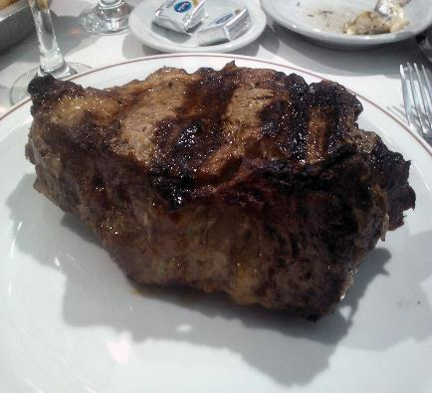
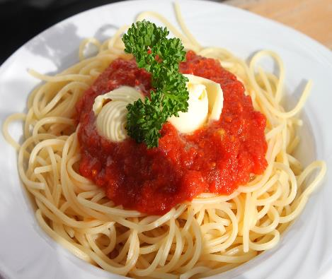
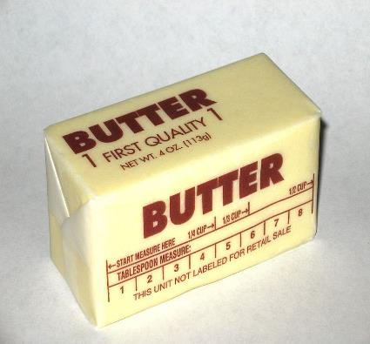
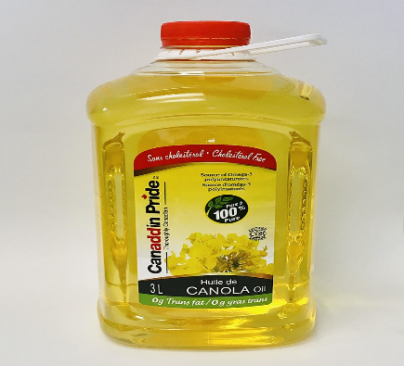
Different types of food nutrients
3 types of food nutrients = Carbohydrates, Proteins, Fats
Name the major nutrients in each food item
(Photos source : https://commons.wikimedia.org/ )
Notes:
All foods when you break them down contain three types of nutrients. Each of these nutrients have an associated amount of energy. Some have more than others. You’ve probably heard of these three kinds of food nutrients before. I’m going to show you some pictures of different kinds of foods and you can tell me what kinds of food nutrients are in them. Some have one or more than one. Emphasize that both butter and vegetable oil are different types of fats. Butter is made from processing the fats in milk and vegetable oils are made by crushing plant seeds that contain oil in them. The last two have the most energy out of all of them. They would make good fuel candidates, want more energy per mass of it.

Slide 4
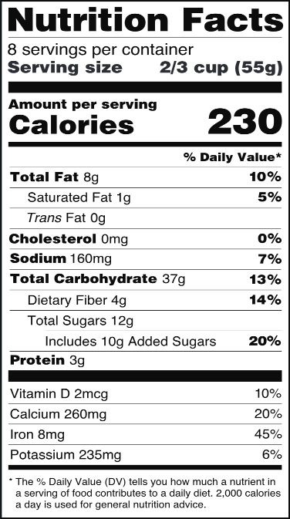
Calories and Nutrition Labels
The energy in food is measured in calories.
A nutrition label gives you the total calories and the mass of each nutrition category.
Calorie = The amount of energy needed to raise 1 mL of water by 1 degree celsius.
(Photos source : https://commons.wikimedia.org/ )
T₁ = 24ºC
1 mL
T₁ = 23ºC
Notes:
Now that we know that foods have different energy in them, we need to know how that energy in them is measured or how we know how much is in it, we know this because .. read first line..Ask the kids if they’ve ever heard of the phrase when you need to exercise you’re ‘burning off calories’. That means by exercising you’re using up the energy that was given to you by the food because it takes energy to do normal activities. Even to breathe takes energy.
We can tell the amount of energy contained in foods we buy at the grocery store by examining its nutrition label. Any type of food package you buy at the grocery has a nutrition label. Have you noticed them before? Show the parts of the label, top gives the serving size and the number of servings in it. The label contains the number of calories and the mass of each food item per serving, not the whole package. Most of the items in bold give the mass amount of each nutrient component, there is total fat, total carbohydrate and protein. Ignore cholesterol and sodium. It doesn’t give amount of calories per nutrient but we could calculate that ourselves. Just need to multiply by the number of calories per gram for each food nutrient. We won’t be doing that in class so don’t worry about calculating it.
Now we know what calories are and used for - give you official definition of a calorie. Write this down in notebook.

Slide 5
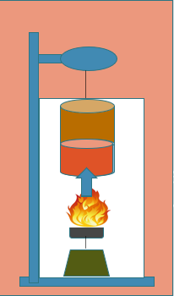
Food can be Fuel Activity
Objective: Find the energy content in a piece of food in Calories.
When the food is burned, energy is transferred from the food item to the water inside the can.
Measuring the temperature of the water before and after burning the food can tell us the energy in the can.
Notes:
** Important : Have the students copy each of these sentences into their binder.

Slide 6
The loss of heat from the food results in a gain of heat for the water in the can.
Q = M * C * ΔT
Q= Heat energy (Calories)
M = Mass of the water in the can
ΔT= Change in temperature of the water
Notes:
Say that we can calculate the amount of energy in a piece of food by using the following equations below. The first one is …. This tells us (repeat the phrase from above). So now all we need to do is just calculate the heat gain in the water which is Qw using the second equation. After telling them each variable in the equation. Tell them they’ll use this equation after they do this lab in another period to calculate the energy in the food.

Slide 7
Assign Food and Create Hypothesis
Each team will burn only 1 food item. Will assign food items.
Almonds 2. Cheetos 3. Marshmallows
HYPOTHESIS:
If various foods are burned and used to heat water, then _________ will have the most calories.
Notes:
Some of the food items will burn better than others. Therefore, this leads into the hypothesis of the experiment, what you expect to happen. Write down hypothesis. After that then will assign food items.

Slide 8
Safety Issues (read only, do not copy)
Work on a non-flammable surface.
Long hair needs to be tied back.
All students must wear safety glasses.
Always use oven mitts to handle items that may be hot.
Notes:
Have students get safety glasses and the hair ties for the girls. Point out oven mits are on the station. Have the students also get the mass balances, graduated cylinder with beaker of water, cork with paper clip, petri dish. Pass out the food item for each group.

Slide 9
Name the food items burning

Slide 10
Name the food items burning
ALMONDS
PEANUTS
POTATO CHIPS

Slide 11
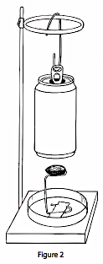
What do we need to measure? 🤔
Weight of water 💧in soda can
Temperature of water before fire 🔥
Temperature of water after fire 🔥
💧💧💧
💧💧💧
💧💧💧
🔥

Slide 12
Procedure
In your groups put these steps in order.
Call an adult to light food on fire.
Do calculations to find number of calories in your food item.
Start timer once food catches on fire.
Record initial weight of food item.
Record final weight of food item.
After snack finishes burning, measure final temperature of water and record.
Measure initial temperature of water and record.
💧💧💧
💧💧💧
💧💧💧
🔥

Slide 13
Procedure
Record initial weight of food item. d)
Measure initial temperature of water and record. g)
Call an adult to light food on fire. a)
Start timer once food catches on fire. c)
After food item finishes burning, measure final temperature of water and record. f)
Record final weight of food item. e)
Do calculations to find number of calories in your food item. b)
💧💧💧
💧💧💧
💧💧💧
🔥

Slide 14
Procedure
Record initial weight of snack. d)
Measure initial temperature of water and record. g)
Call an adult to light food item on fire. a)
Start timer once food catches on fire. c)
After food item finishes burning, measure final temperature of water and record. f)
Record final weight of food item. e)
We will now do step 1-6 of the lab. We will cover step 7 after we clean up.
💧💧💧
💧💧💧
💧💧💧
🔥

Slide 15
How do we find the energy in the food item?
We need an equation 😱 😱 😱
An equation has variables and an equal sign (=)

Slide 16
Q
m
C
ΔT
Heat energy
Mass
Specific heat
Change in temperature
Variables of the equation
Δ= change (final – initial)
T= temperature

Slide 17
Heat energy
Mass
Specific heat
Change in temperature
C
Q
m
ΔT
Instructions: Connect variable to name

Slide 18
Heat energy
Mass
Specific heat
Change in temperature
Instructions: Name the variable
Q m
C ΔT

Slide 19
Q
m
C
ΔT
Instructions: Name the variable
heat energy mass
specific heat change in temperature

Slide 20
Q
m
C
ΔT
Heat energy
Mass
Specific heat
Change in temperature
calories= cal
gram = g
Cal/ g °C
Celsius degree = °C
Units

Slide 21
ENERGY Equation
Q = m x C x ΔT
Notes:
Do the cancelling of the units on the board

Slide 22
Activity: Sample Calculation 😍
Mass of water being heated = 50 g
Initial temperature of water = 28 $℃$
Final temperature of water = 90 $℃$
Specific heat of water = 0.001 $\frac{Cal}{g∗℃}$
To find the energy in the food, use the following equation.
Q = m x C x ΔT
Q = m x C x ΔT

Slide 23
Sample Calculation
To find the energy in the food, use the following equation..
Q = m x C x ΔT

Slide 24
Sample Calculation
50 g = m
28 $℃$ = Tinitial
90 $℃$ = Tfinal
0.001 $\frac{Cal}{g∗℃}$ = C
Find the energy in the nut. Use the following equation.
Q = m x C x ΔT
Q = m x C x (Tfinal – Tinitial)
Q = (50g) x (0.001 $\frac{Cal}{g∗℃}$ ) x (90$℃$ – 28 $℃$ )
Q = (50g) x (0.001 $\frac{Cal}{g∗℃}$ ) x (6$2℃$ )
Q = 3.1 Cal
The energy found in the food item was 3.1 Calories.

Slide 25
ENERGY Equation
Now, use this equation to find Q (calories) of the food item you burned in this activity!
Q$\left(cal\right)$= m$\left(g\right)$x C $\left(\frac{Cal}{g∗℃}\right)$ x ΔT $\left(℃\right)$
Q = m x C x ΔT
Q = m x C x ΔT
Notes:
Do the cancelling of the units on the board

Slide 26
Closure
Which food item contains the most energy?
2. Which food is most efficient, or has the most energy in the smallest mass?
Extension Question
3. Which food would make the best fuel to carry on a long hike? Why?

Slide 27
Leveling up
1. How does the energy contained in these food substances get released in your digestive system when you eat food?
2. What does your stomach do to “unlock” these nutrients besides burning them?

Slide 28
Exit Ticket
How would we measure the calories contained in a food item that does not burn very easily?

Slide 29
Author Biographies Matthew Katterman is a PhD graduate student at the University of Arizona studying Biosystems Engineering. He is interested in irrigation engineering along with computer modeling of the guayule production system. He also has an intense interest in bioproducts and biofuels production. Matthew is a native of Tucson, Arizona, and received his Bachelor’s in Chemistry in 1997 as well as his Masters in Agricultural and Biosystems Engineering in 2004 from the University of Arizona. Traci Klein Traci started her graduate work in Plant Sciences at the University of Arizona and worked as a lab researcher for several years. Traci then began working as a long-term substitute in the Baboquivari School District on the Tohono O’odham nation while taking online education classes. She received her teaching certificate and has been teaching 7th grade science at Valencia Middle School for 6 years. She has also been the MESA (Math Engineering Science Achievement) Club Advisor for 5 years. Matt Swanson is a lifelong Arizona resident and an educator with experience teaching science at the middle school and high school levels. He is now working for the Arizona State 4-H office as a Curriculum Specialist, where he continues to enjoy bringing learning experience to youth. He received both his undergraduate degree in philosophy and his graduate degree in science education at the University of Arizona.
Sustainable Bioeconomies for Arid Regions Center of Excellence: https://sbar.arizona.edu
Any opinions, findings, conclusions, or recommendations expressed in this PowerPoint lesson are those of the author(s) and do not necessarily reflect the view of the U.S. Department of Agriculture. Grant # 2017-68005-26867.

