Slide 1
Soil: More Than Just Dirt

Slide 2
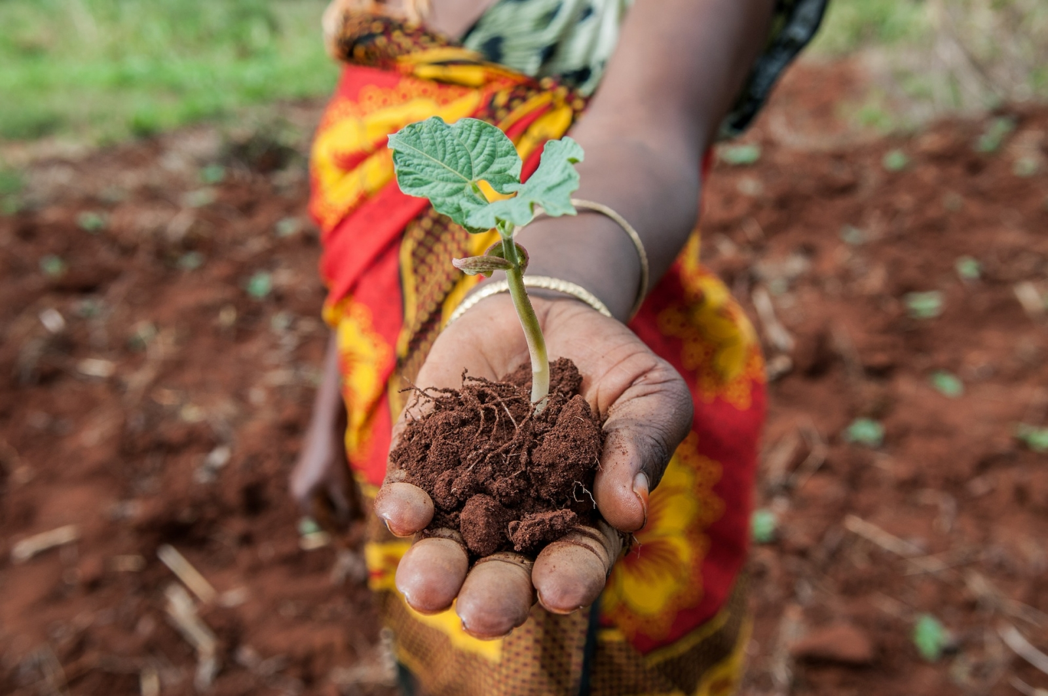
Bell Ringer
Name three ingredients that make up the soil you find in a garden. If you are not sure, guess!
This Photo by Unknown Author is licensed under CC BY

Slide 3
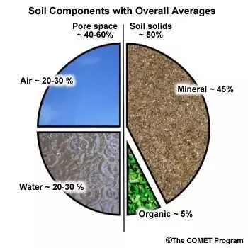
Part 1: What is Soil texture?
Solids (Minerals and organic matter)
Liquid (water)
Gases (oxygen)
Living organisms (worms)
Micro-organisms (bacteria, fungi)

Slide 4
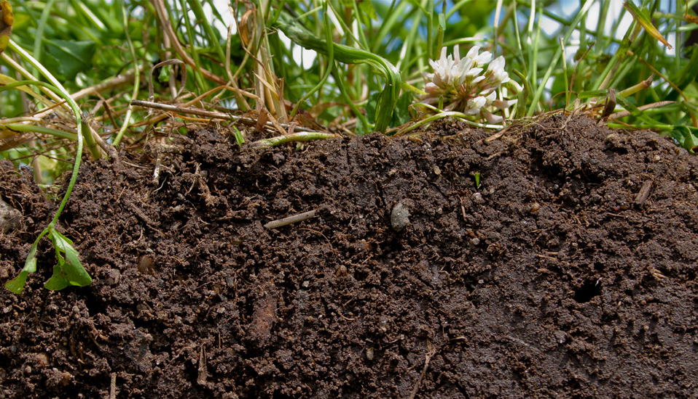
Your Objective
1. Be able to estimate specific types of soil using the "texture by feel" and soil triangle methods.
2. Demonstrate understanding of the basic ways in which soil has influenced cultures in the Southwest.

Slide 5
What is Soil? An Indigenous Perspective
"The Native American is from the soil"- Luther Standing Bear (Lakota)
"Mother earth is not a resource, she is an heirloom" – David Ipina ( Yurok)
Notes:
Although the way soils are used and classified in different Native American cultures are varied and diverse, generally the indigenous perspective on soil is that it is to be protected and preserved for future generations. In other words, soil is not just to be used but also restored so that can be sustained for many generations.
In part three, you will learn more about the indigenous perspective on soil.

Slide 6
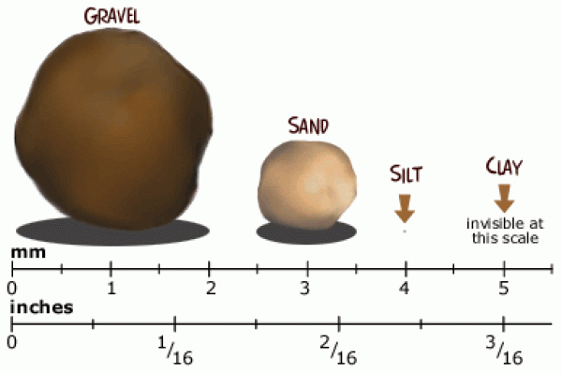
Soil Classification: Based on particle size
SOIL TYPES | PARTICLE SIZE RANGE (mm)
Gravel | >2
Sand | 2 to 0.05
Silt | 0.05 to 0.002
Clay | <0.002

Slide 7
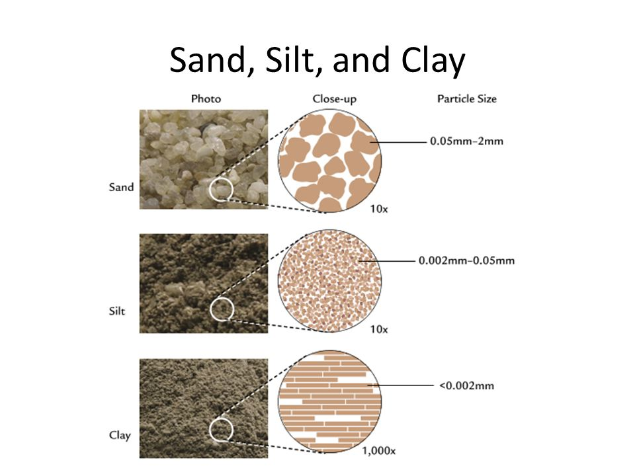
Soil Classification
Soil consist of all three types of particles
Sand, Silt, and Clay
The relative proportion of the three types of particles determines the soil type This is called Soil Texture
Sand % + Silt% + Clay% = 100%

Slide 8
Prepare soil to use the Soil Texture Triangle

Slide 9
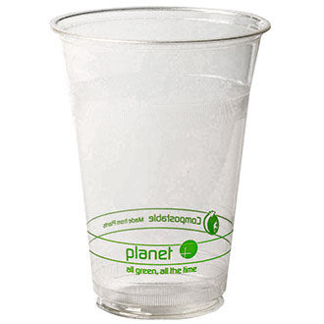
Prepare the soil sample
Use 1 or 2 of the CLEAR PLASTIC (or glass) cups at your station to get a soil sample. The sample size should fill your cup ¼ of the way to the top of the cup.
Pour out the soil onto a paper towel.
3. Remove any rocks, organic matter, bugs, etc. from the soil. Add the soil back to the cup and discard the excess material outside.
About ¼ full

Slide 10
4. Carefully add 3 times as much water as soil to the container.
DO NOT pour any soil in the sink.
5. Stir soil for at least 3 minutes with the spoon.
6. Place container in a spot that won't get bumped.
7. Let container settle for 30 minutes or more.
Water
Soil

Slide 11
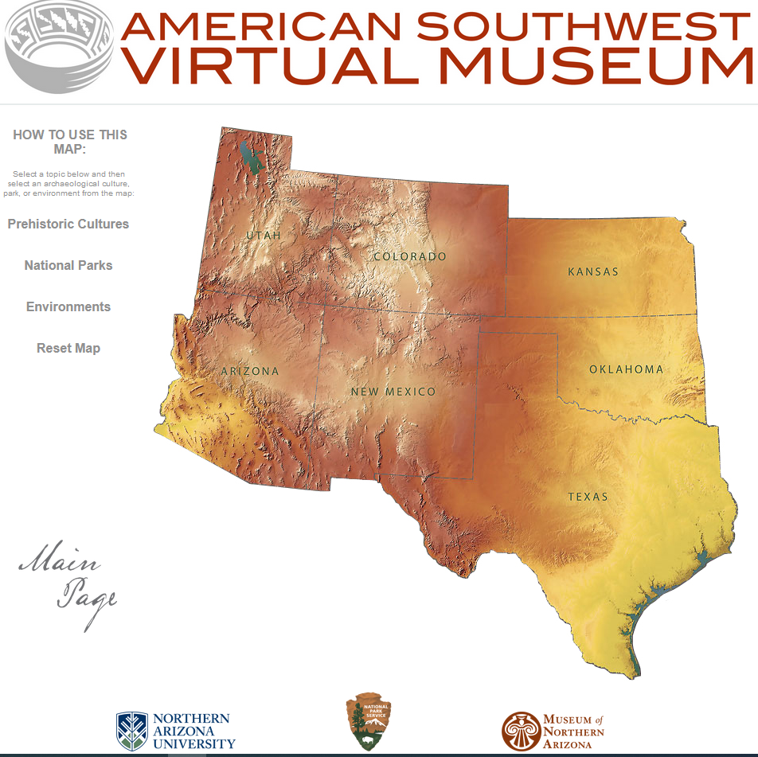
Part 2: Exploration of Southwestern Soil
through Pottery

Slide 12
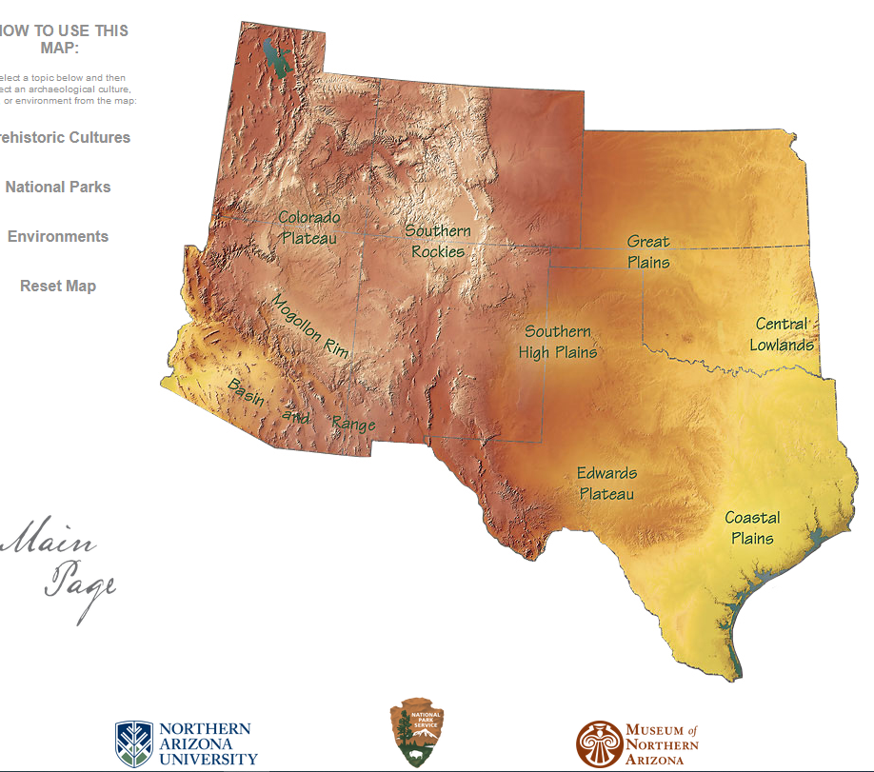
1. Go to the interactive map at the American Southwest Virtual Museum https://swvirtualmuseum.nau.edu/
2. Click on ENVIRONMENTS, and then click on the MOGOLLON RIM.
3. Find the section on GEOLOGY and summarize this information in 2 sentences on your handout.

Slide 13
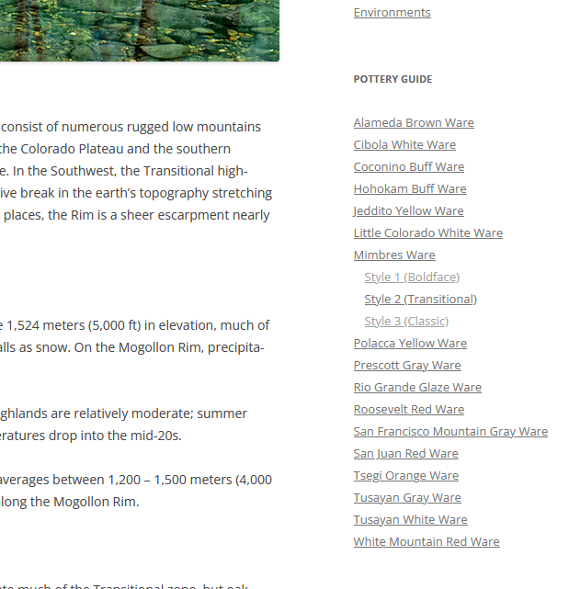
4. On the right-hand side of the page, there is a list of pottery types. Find MIEMBRES and look at the three examples.
What do these three examples of pottery have in common?
Do the materials match the geology of the Mogollon region?
Do you think soil type and the geology of the region influenced the design of these pieces?

Slide 14
5. Go back to the interactive map at the American Southwest Virtual Museum https://swvirtualmuseum.nau.edu/
6. Click on ENVIRONMENTS, and then click on the COLORADO PLATEAU.
7. Find the section on GEOLOGY and summarize it on your handout.

Slide 15
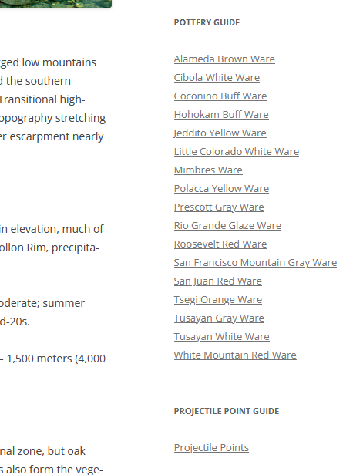
8. On the right-hand side of the page, there is a list of pottery types. Find ROOSEVELT RED WARE and pick three examples to look at.
What do these three examples of pottery have in common?
Do the materials match the geology of the Colorado plateau region?
Do you think soil type and the geology of the region influenced the design of these pieces?

Slide 16
9. What is different about the geology of the MOGOLLON and COLORADO PLATEAU areas? How is this reflected in the pottery produced in each region?
Watch the following video https://vimeo.com/68407614 (also in the video section of the American Southwest Virtual Museum website).
10. What is one thing that is represented by pottery other than its practical uses?

Slide 17
Part 3- Using the Soil Texture Triangle

Slide 18
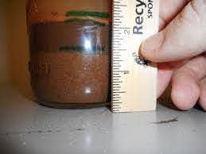
Once the soil has settled, there should be 3 distinct layers. Measure the height (in mm) of each layer. To calculate the percentage of each soil type, you will also need to measure the total height in cm of the soil in the cup.
The bottom layer of your soil sample represents SAND.
The middle layer represents SILT.
The top layer represents CLAY.

Slide 19
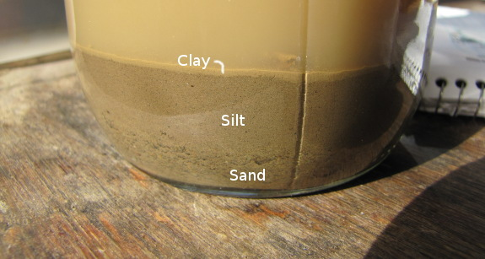
Calculate the percentage of each layer. (you will do this calculation 3 times- one time for each layer)
Height of layer X 100% = % of sand, silt or clay
Total height of
soil in cup

Slide 20
Example Calculation
Example Calculation: Let’s say you measure… 15 mm sand, 10 mm silt, 5 mm clay= 30 mm total
Sample Calculations-
Sand: 15mm/30 mm= 0.5 x 100= 50%
Silt: 10mm/30 mm= 0.33 x 100= 33%
Clay: 5 mm/30 mm = 0.167 x 100= 16.7%
The percentages should add up to 100%

Slide 21
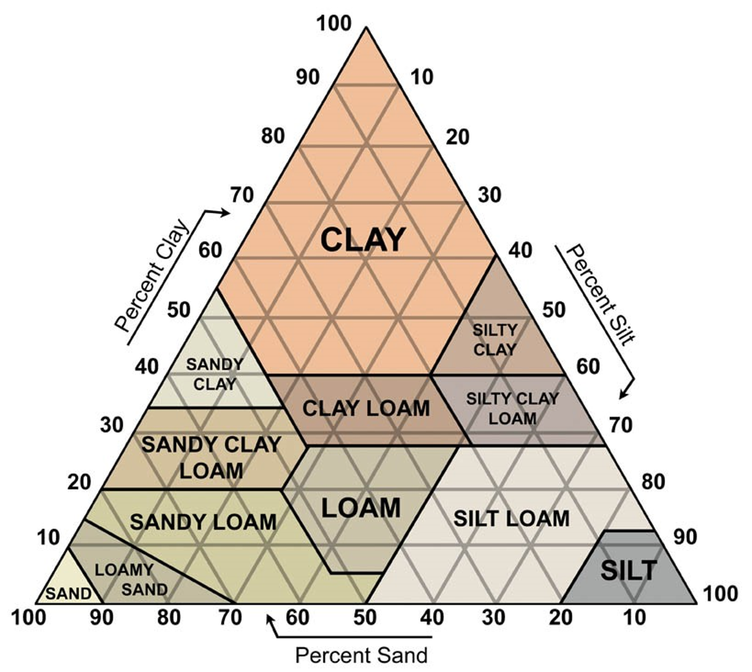
Example
50%
7. Find the soil type using the soil texture triangle.
On the bottom of the triangle, find the percentage that represents SAND and use a ruler to trace a parallel line to the closest grey gridline through the rest of the triangle.

Slide 22
Example
50% 33%
7. Find the soil type using the soil texture triangle.
- On the right of the triangle, find the percentage that represents SILT and use a ruler to trace a parallel line (down, to the left) to the closest grey gridline through the rest of the triangle.

Slide 23
Example
50% 33% 16.7
Sandy Loam
7. Find the soil type using the soil texture triangle.
- On the left of the triangle, find the percentage that represents CLAY and use a ruler to trace a parallel horizontal line to the closest grey gridline through the rest of the triangle.
8. The region where all three lines intersect is the soil type.

Slide 24
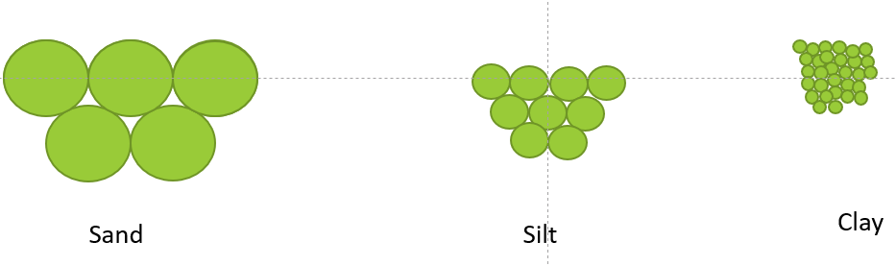
Soil Texture Influence
Porosity: Amount of open spaces or voids or pores between soil particles. These pores are really important as it contains air (oxygen) and water.
a) Macro-pores (> 0.08 mm diameter)
b) Micro-pores (<0.08 mm diameter)

Slide 25
Soil Texture Influence
Drainage: Process by which water moves downward from upper soil layers to lower layers by gravity.
Soil water holding capacity: ability to hold water

Slide 26
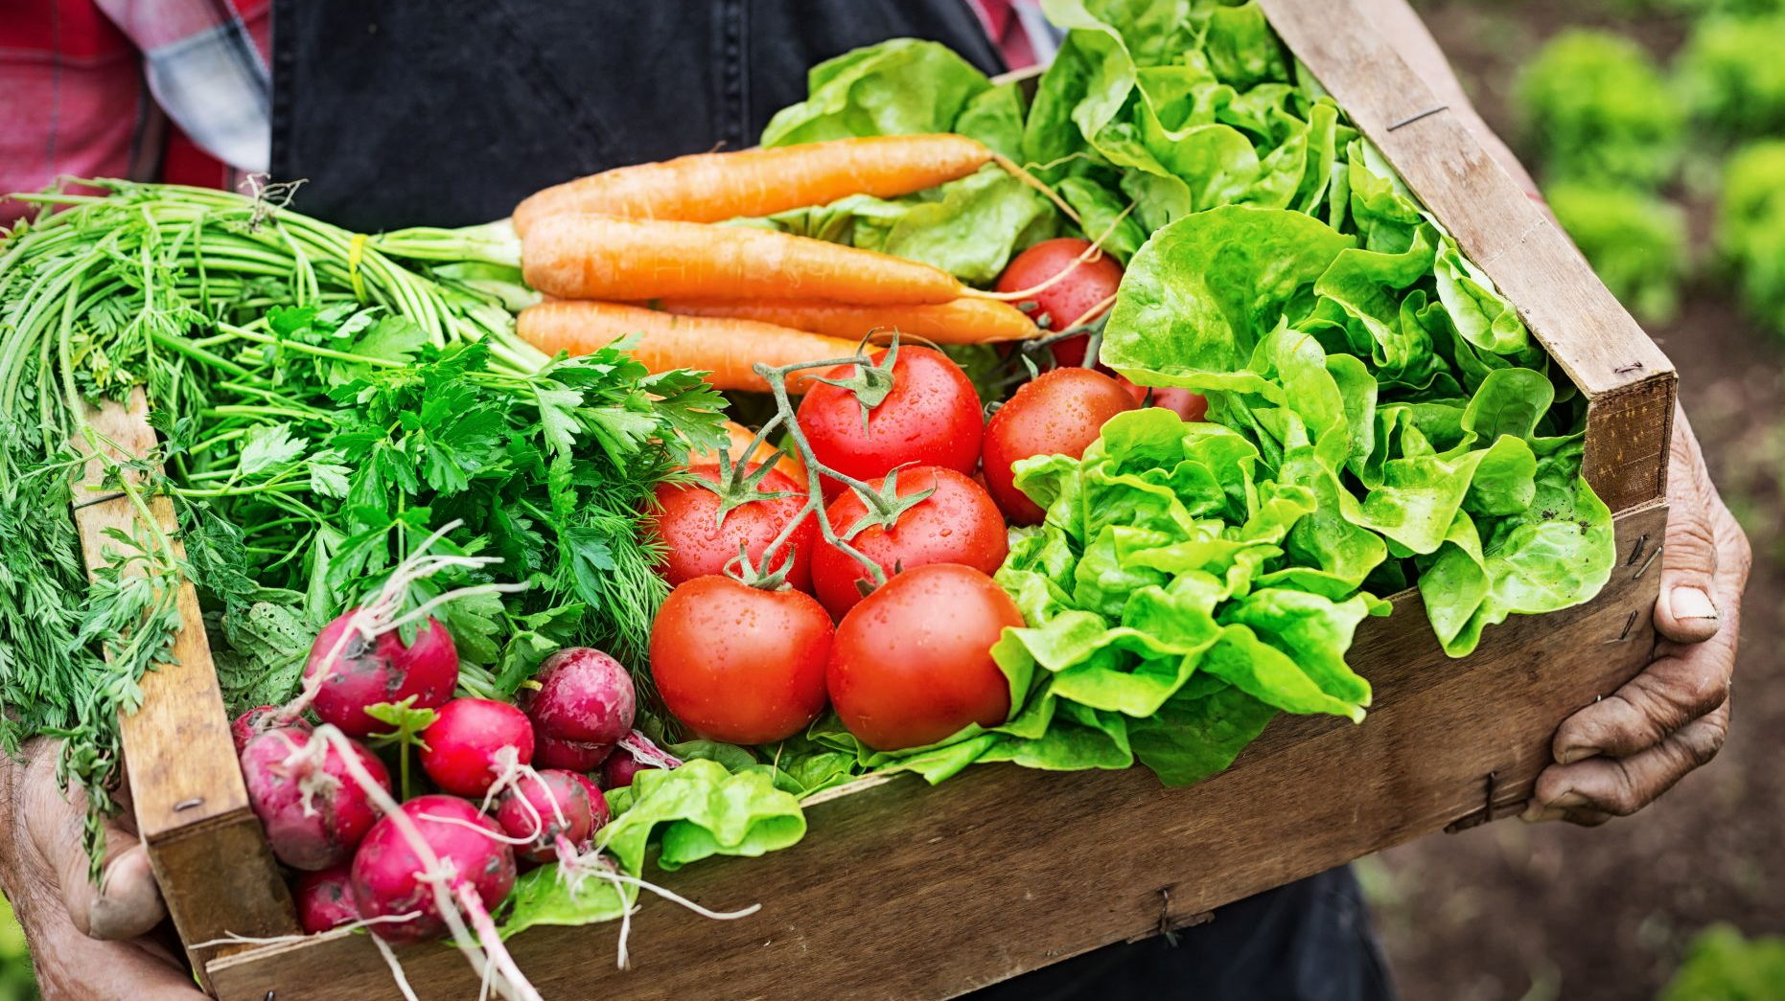
Best Soil Textures for Crops
Sand: carrots, potato, strawberry, lettuce, Figs
Clay: Broccoli, Brussel sprouts, cabbage, squash, pumpkins, rice, walnut
Loam: Beets, bell peppers, basil, apples, onions, okra
The type of soil in a place has affected humans throughout history!

Slide 27
Closure Questions
Name the three soil texture types.
Name three living components of soil.
Leveling up
3. How does soil texture affect food grown in an area?

Slide 28
Pulling it all togther
Name another aspect of life that is affected by soil besides pottery. Your example can be from recently in your own life, or from the examples of native southwestern peoples in the past and present.

Slide 29
Credits
Thank you to NAU, the Museum of Northern Arizona and the National Park Service for creating the Southwest Virtual Museum website.

