Slide 1
The Three Sisters and Companion Planting
Matt Swanson and Juan Arias
University of Arizona Cooperative Extension

Slide 2
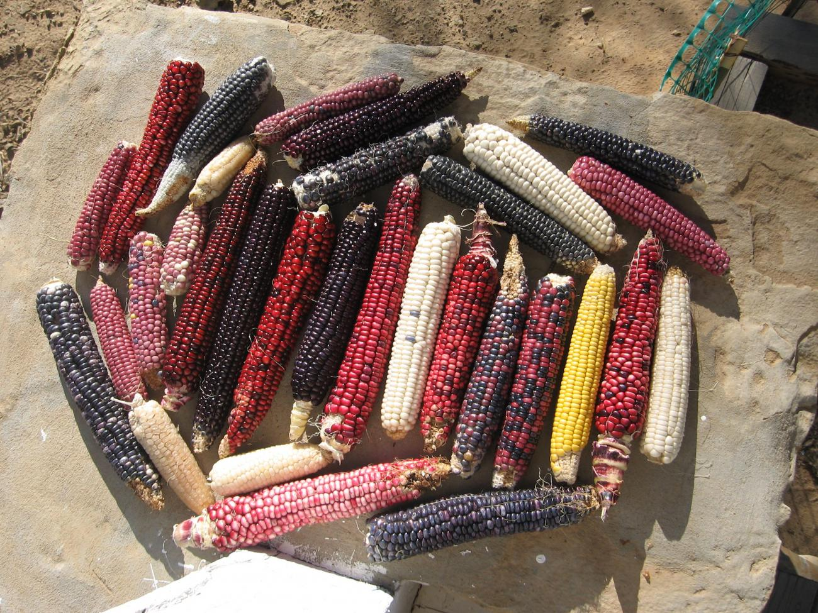
Bellwork
Native American communities have cultivated many different varieties of corn adapted specifically to the southwest bioregion. These varieties have evolved over thousands of years of cultivation by native nations.
A) Why are these types of corn different colors and sizes?
B) Why is corn considered a fundamental, or "staple" crop across the world?

Slide 3
Objective
In this lesson, you will understand the many benefits of carefully planting different types of crops that mutually benefit each other. You will design and plan out your own garden based upon what you have learned.

Slide 4
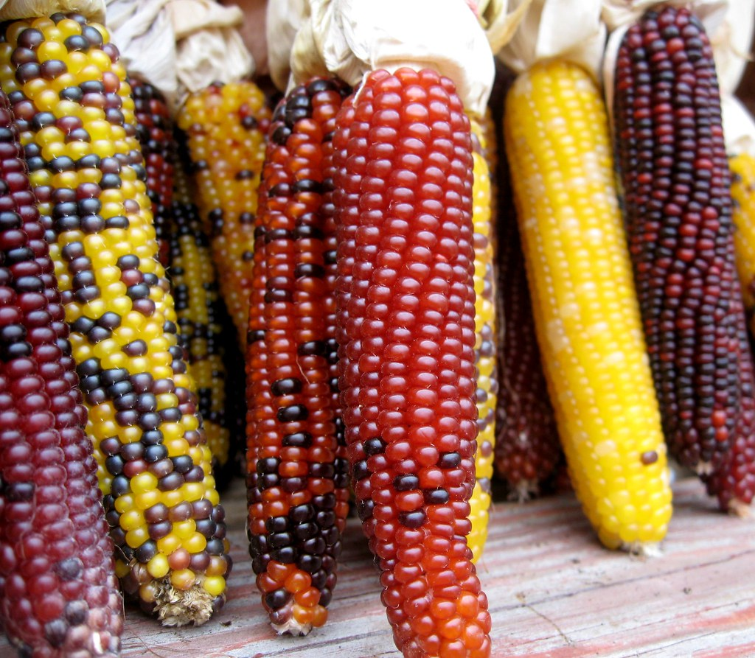
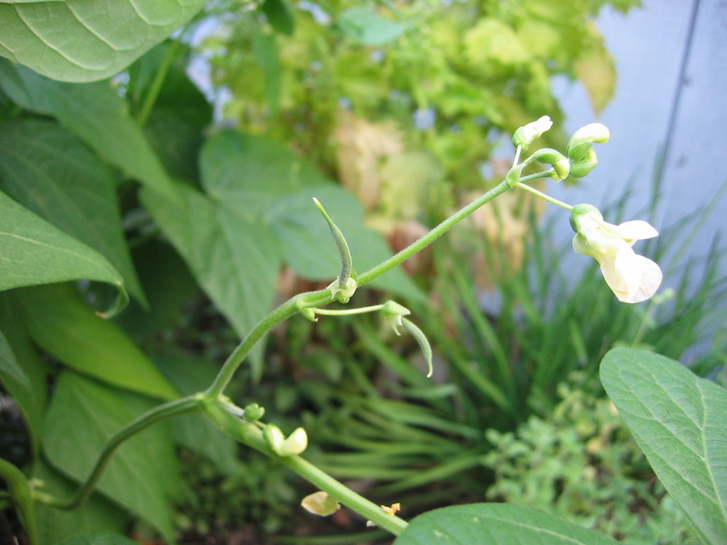
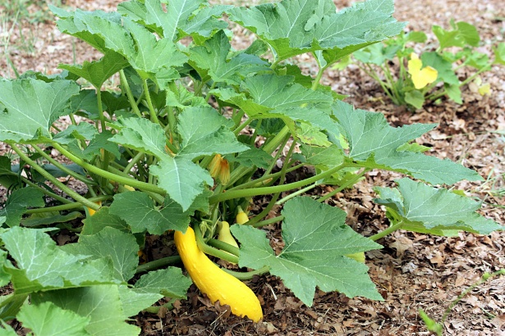
Three Sisters
For many Native American communities, three plants - corn, beans, and squash represent the most important crops and have been cultivated together for thousands of years.
The tradition of growing these three plants is based upon many years of careful observation and experience.
Notes:
The tradition of growing these three plants is based upon many years of careful observation and experience- the Three Sisters work together to help one another grow. More recent scientific research has also verified many of the benefits of growing these three plants together.

Slide 5
Legends
Many Native American communities have their own legends surrounding the three sisters. Here is an excerpt from one legend:
Notes:
You can read this excerpt or play the video: A long time ago there were three sisters who lived together in a field. These sisters were quite different from one another in their size and way of dressing. The little sister was so young that she could only crawl at first, and she was dressed in green. The second sister wore a bright yellow dress, and she had a way of running off by herself when the sun shone and the soft wind blew in her face. The third was the eldest sister, standing always very straight and tall above the other sisters and trying to protect them. She wore a pale green shawl, and she had long, yellow hair that tossed about her head in the breeze. There was one way the sisters were all alike, though. They loved each other dearly, and they always stayed together. This made them very strong. (Courtesy of Project I'M READY, Northeastern State University)

Slide 6
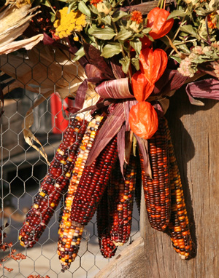
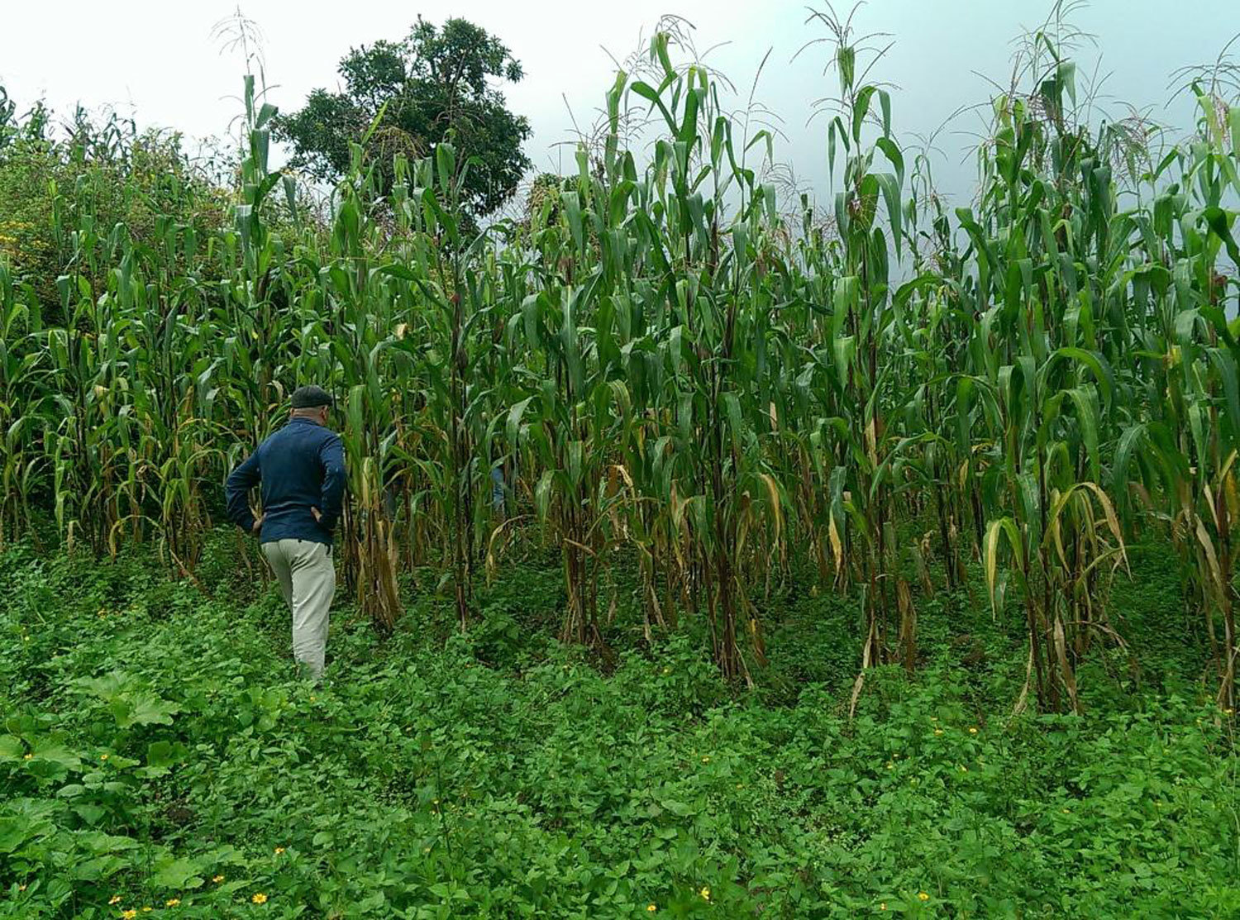
Naadáá'/Qaa-o/Maíz/Corn (Diné/Hopi/Spanish/English)
"The third was the eldest sister, standing always very straight and tall above the other sisters and trying to protect them. She wore a pale green shawl, and she had long, yellow hair that tossed about her head in the breeze."
The tall, straight stalks of corn provide a place for the bean plants to climb above the squash and other plants.
Corn is rich in carbohydrates and certain amino acids, and is used in many
types of food around the world.

Slide 7
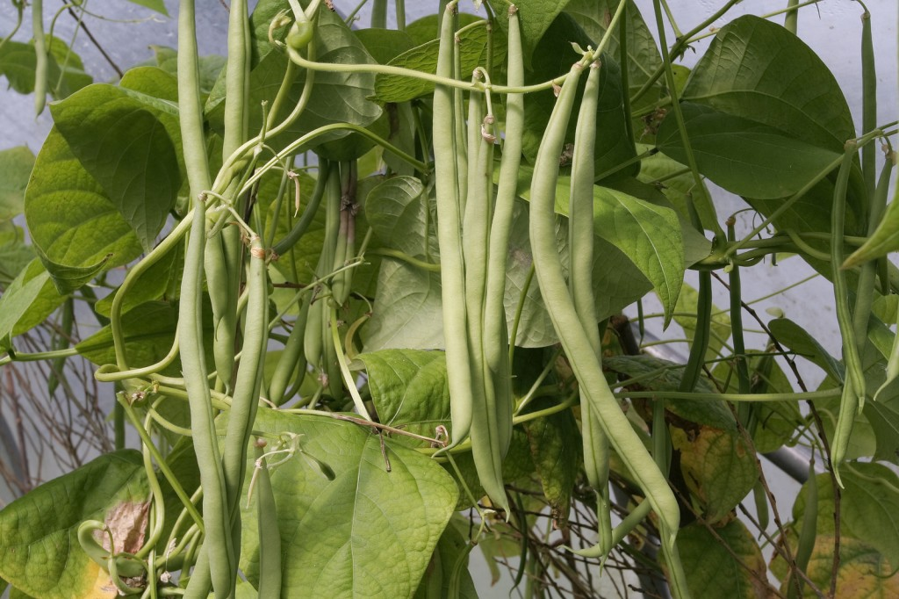
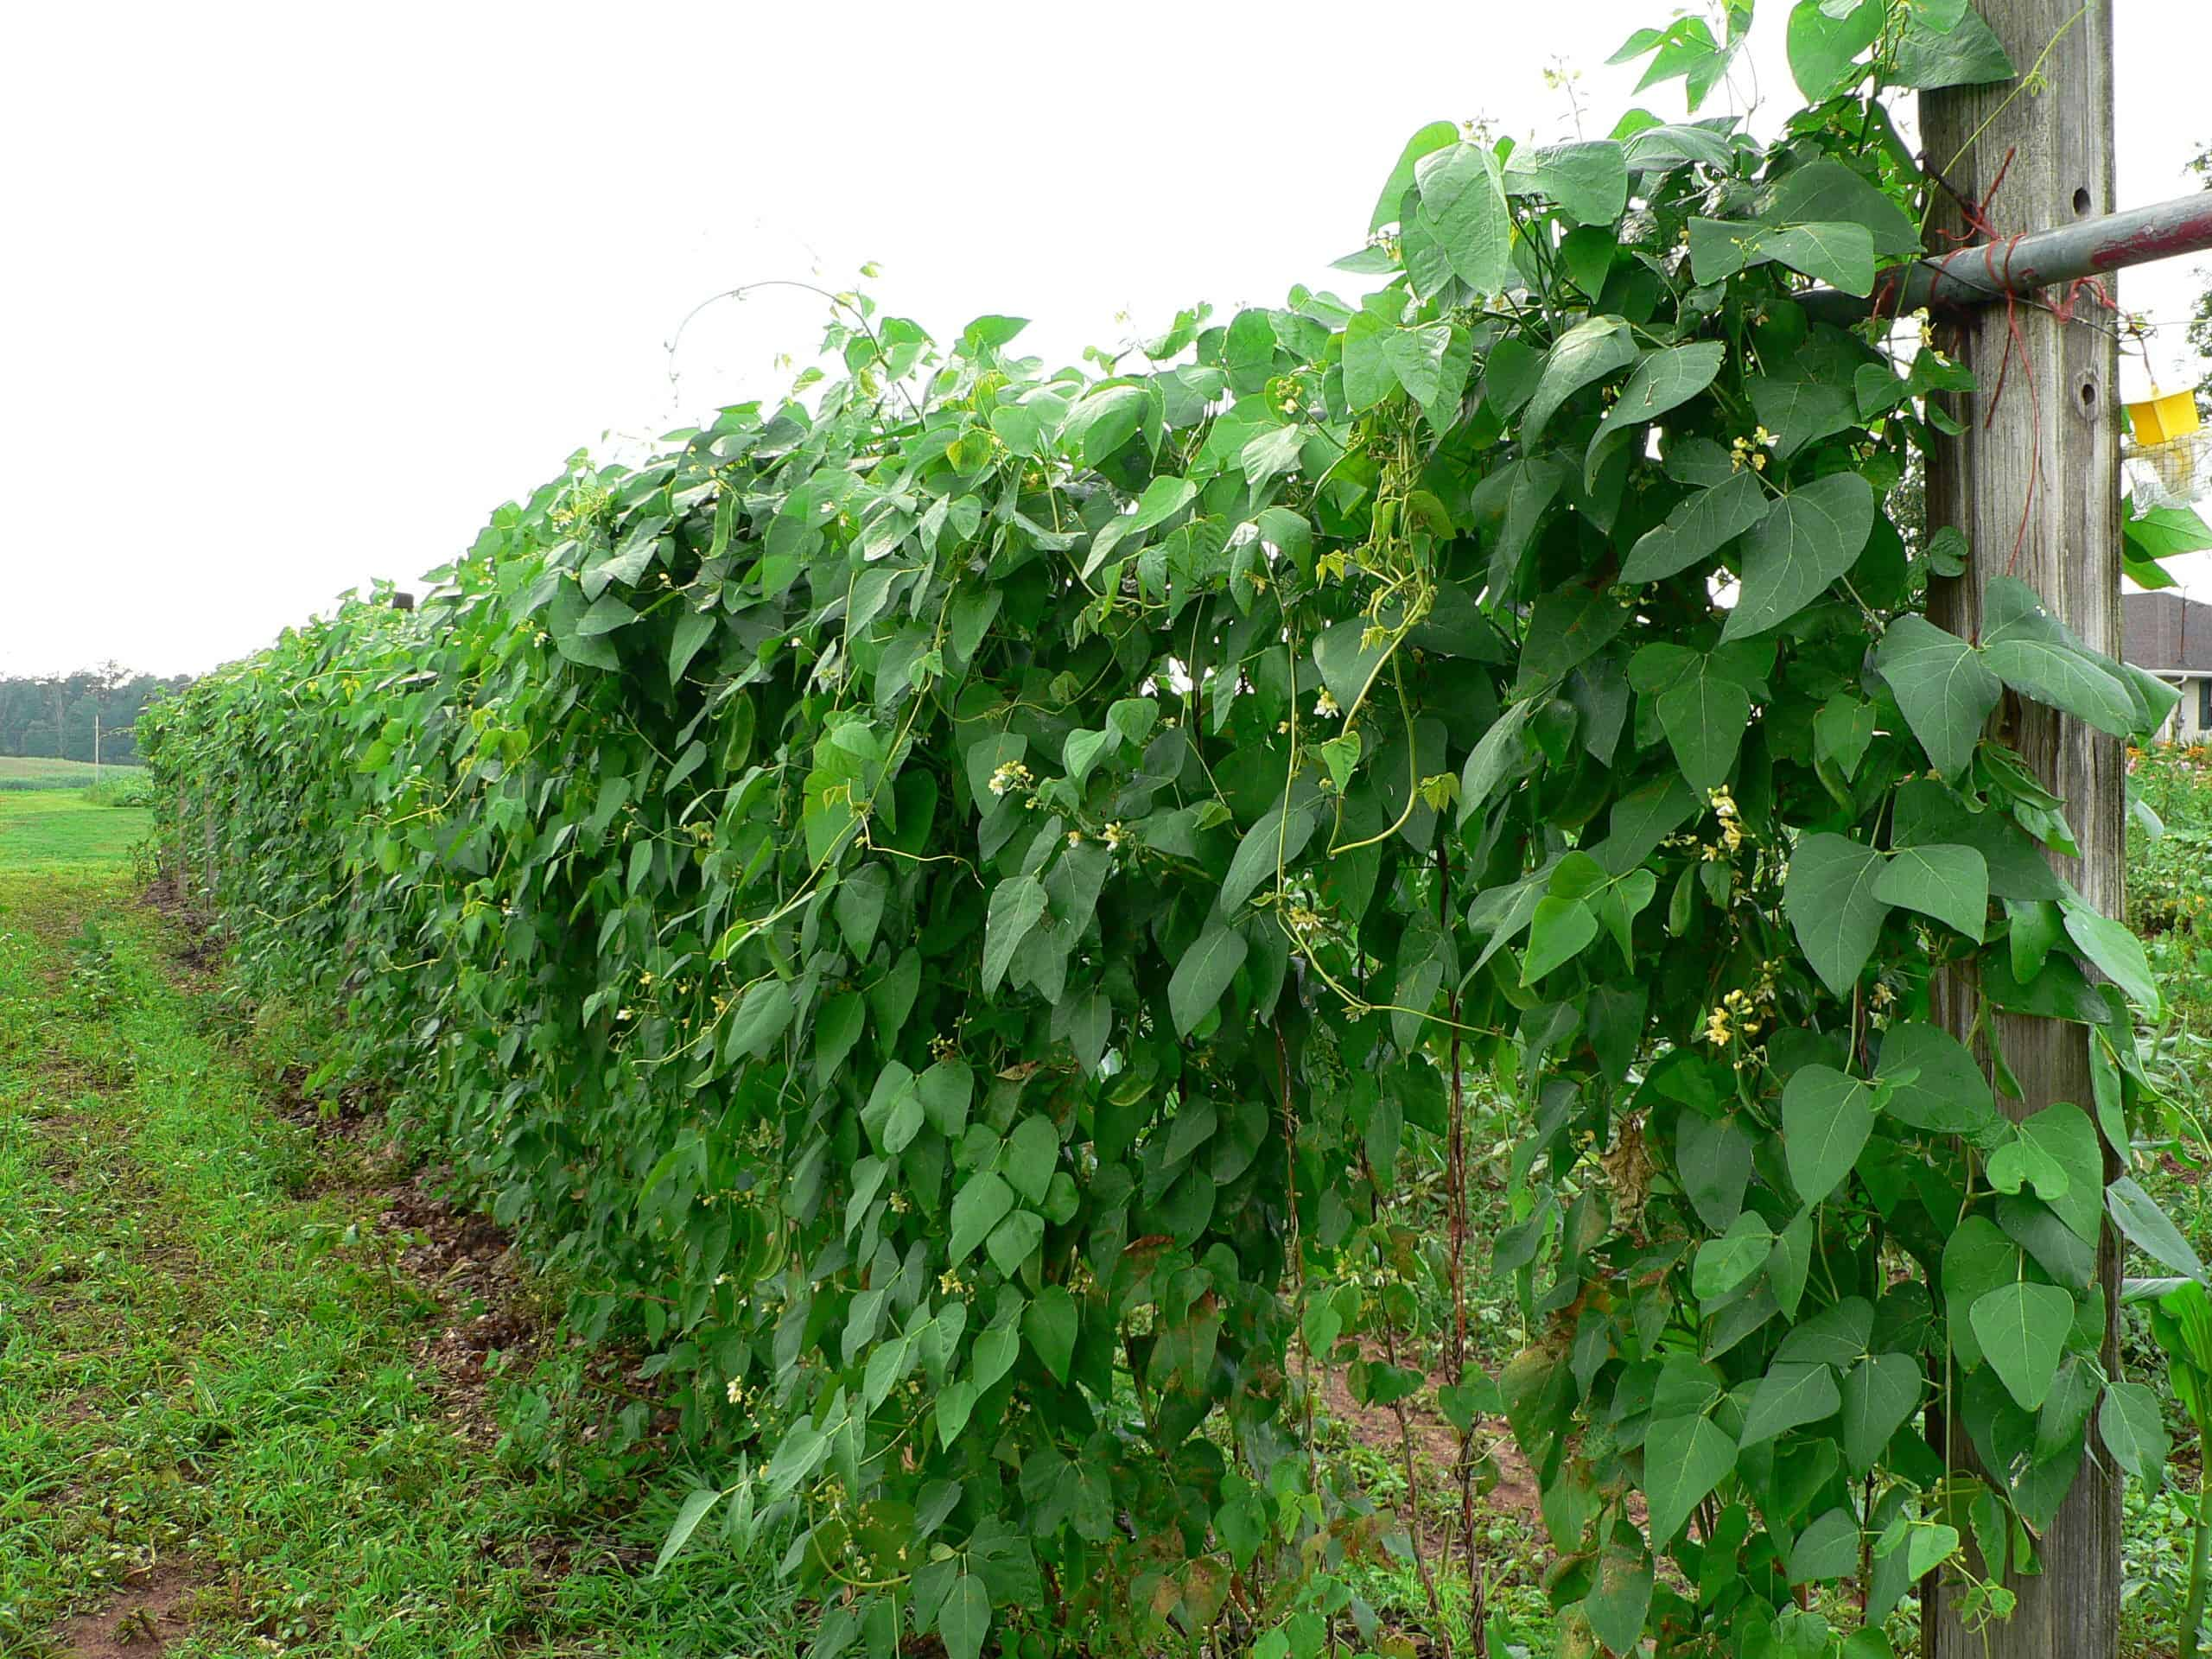
Naaʼołí /Paapu/Frijoles/Beans (Diné/Hopi/Spanish/English)
"The second sister wore a bright yellow dress, and she had a way of running off by herself when the sun shone and the soft wind blew in her face."
Beans provide nitrogen in the soil by "fixing" it from the atmosphere into a form that plants can use. Nitrogen is needed by all plants but there is only a small amount in soil.
Many bean plants grow like vines on other plants or surfaces.
Notes:
Beans are rich in protein and different amino acids from corn.

Slide 8
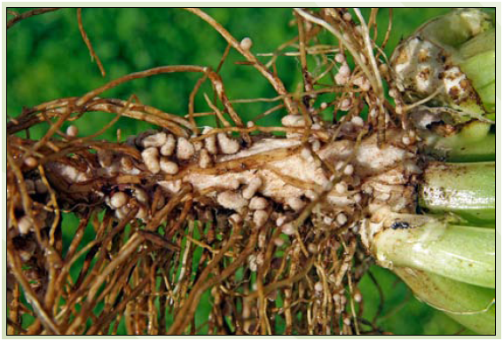
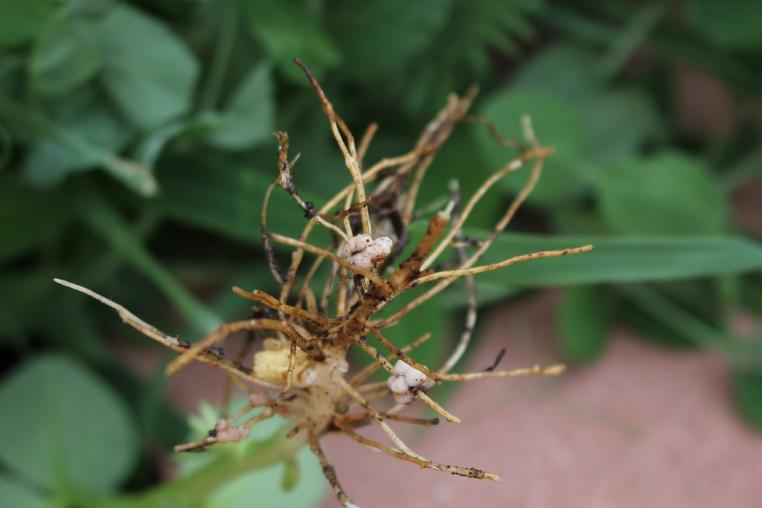
Nitrogen fixing crops
Bean plant roots have the ability to take, or "fix" nitrogen from the atmosphere and make it into a form that plants can use, thanks to a partnership with bacteria that live on the roots that can capture the nitrogen in the air.
This nitrogen fixing that bean plants can do adds nitrogen to the soil for all other plants to use!
Question: Where is nitrogen mostly found on earth? Look it up if you are not sure!
The Nitrogen fixing bacteria live in the little bumps (nodules)
On the roots of bean plants.

Slide 9
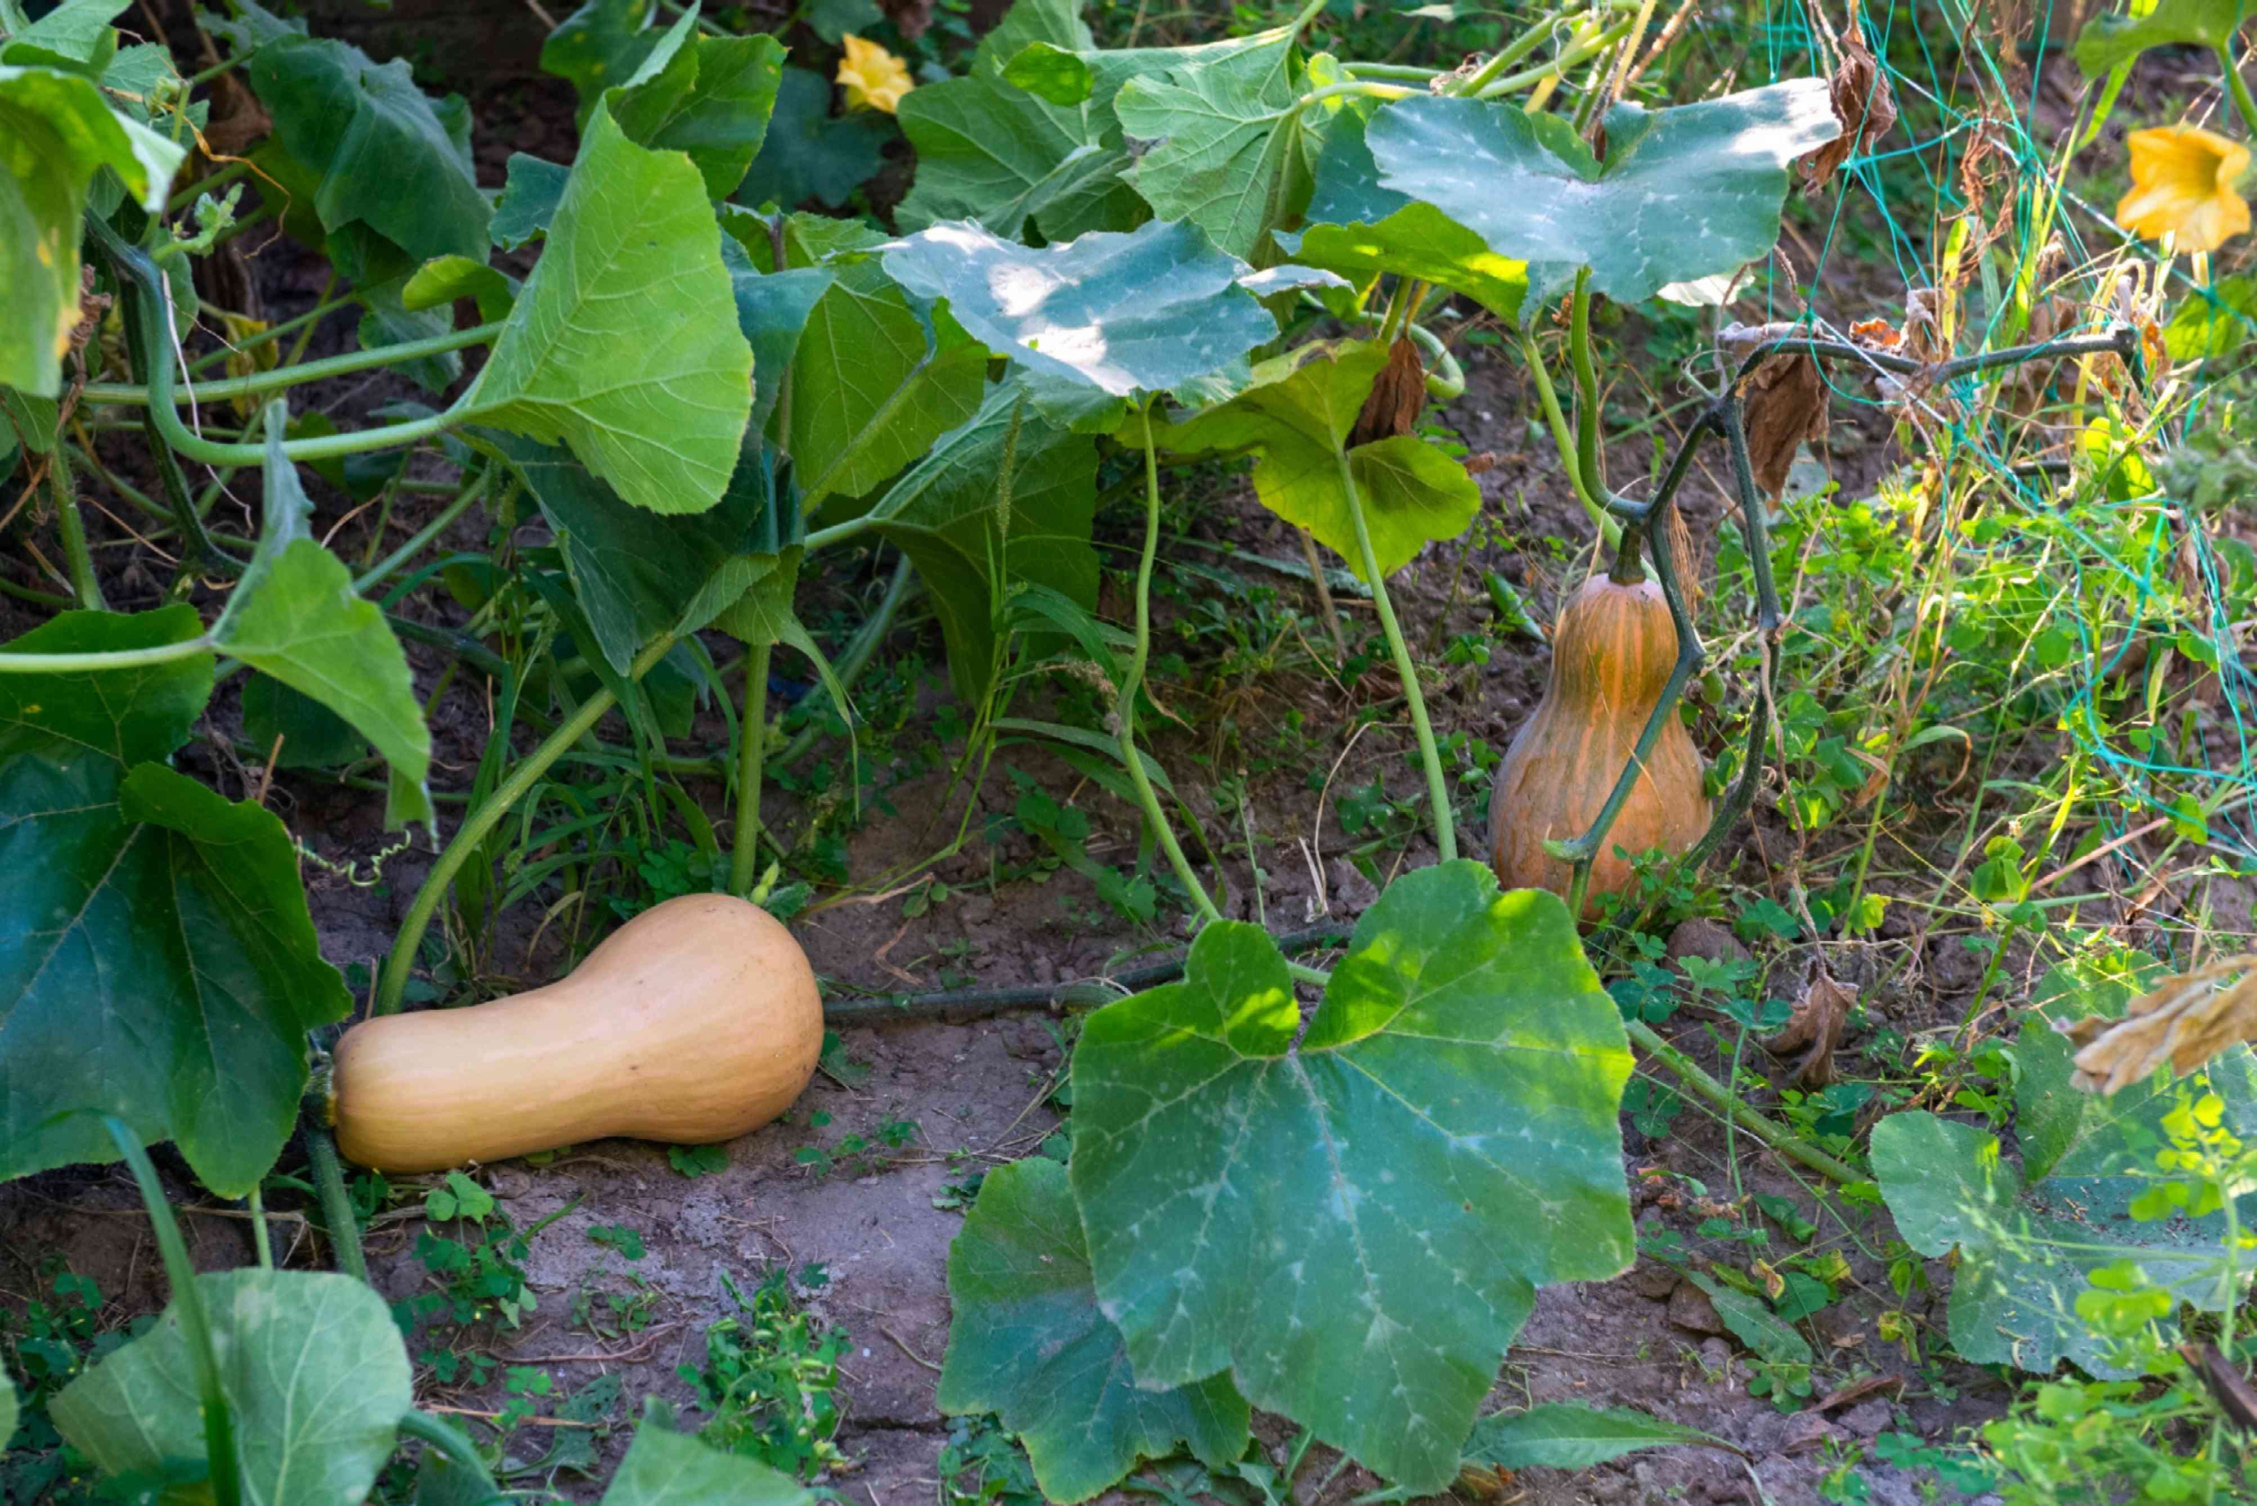
Naayízí/Batanga/Calabaza/Squash (Diné/Hopi/Spanish/English)
"The little sister was so young that she could only crawl at first, and she was dressed in green."
Squash plants grow along the ground, and their large leaves shade the soil to prevent moisture loss.
Squash plants also help prevent weeds from competing with the other sisters.
Squash is Rich in vitamins and minerals.
Notes:
Squash is a type of curcubit, a family of plants including watermelons, melons and gourds.

Slide 10
Nutritional benefits
Together, the three sisters make a balanced diet.
naadáá'/Qaa-o/Maiz/Corn- rich in carbohydrates and certain amino acids
Naaʼołí /Paapu/Frijoles/Beans- rich in protein and different amino acids from corn
Naayízí/Batanga/Calabaza/Squash- Rich in vitamins and minerals
Together, the three sisters provide all nine essential amino acids. Amino acids are what combine in your body to build muscles, cause chemical reactions in the body, transport nutrients, prevent illness, and many other functions.
Question: Can you think of another meal that is considered a "complete" meal?

Slide 11
Question: Can you think of another meal that is considered a "complete" meal?
USDA's My Plate Guidelines
https://www.myplate.gov/

Slide 12
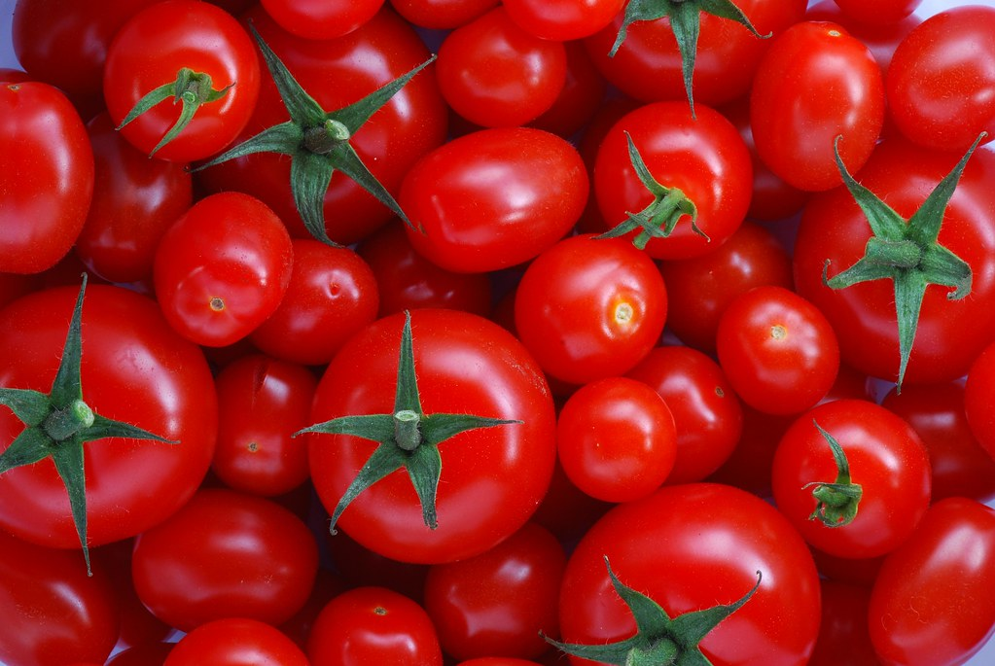
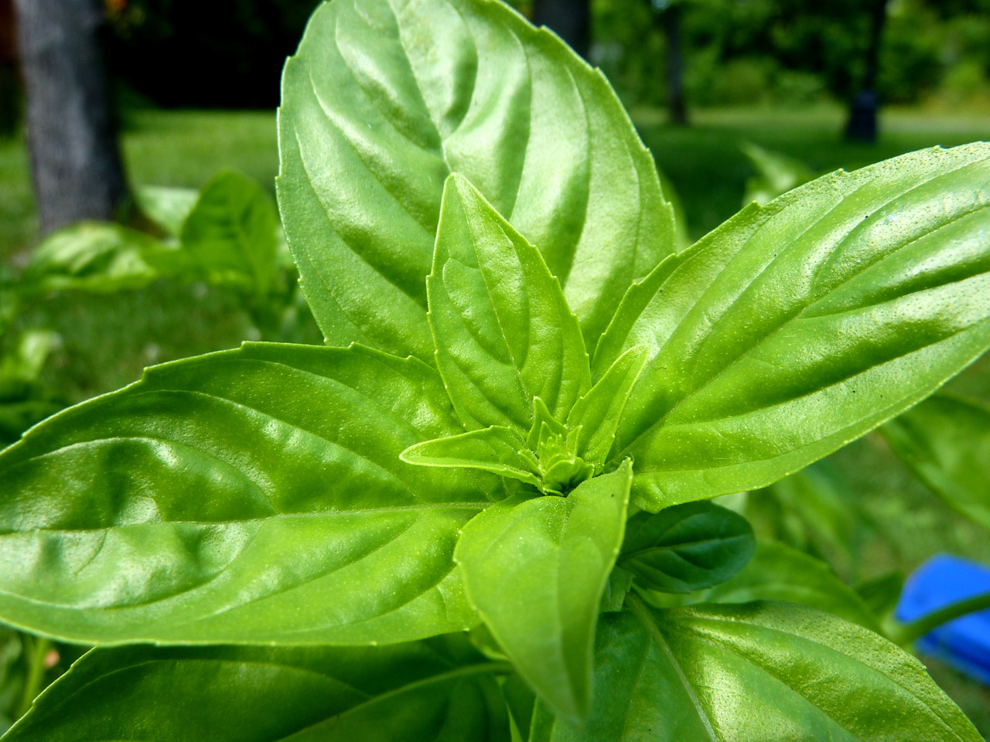
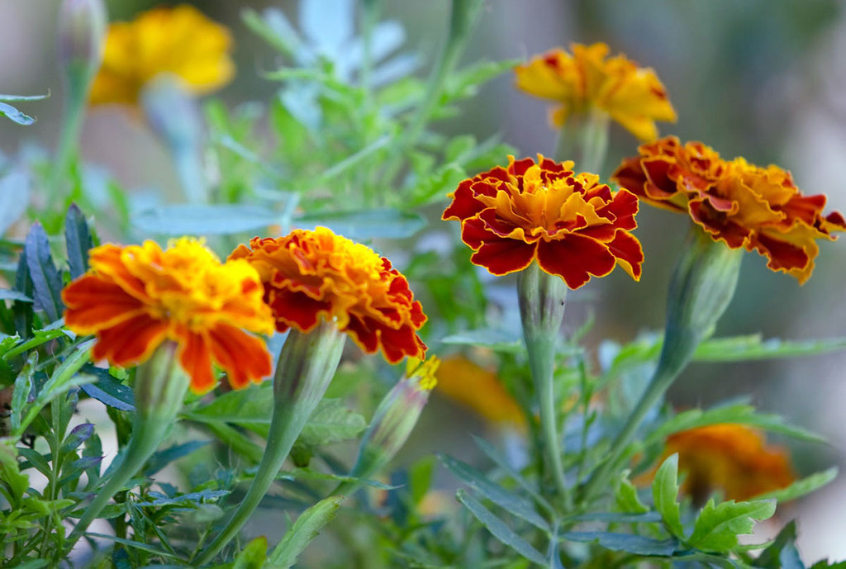
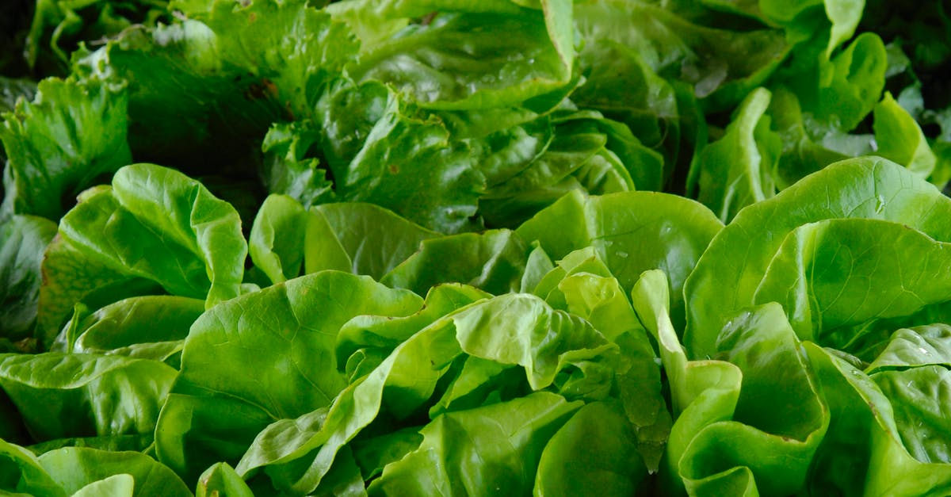
What is Companion Planting?
Many Native American agricultural traditions discovered and perfected the cultivation of the three sisters in many ways over the centuries, depending on the environmental conditions of a region.
More recently, a word has developed for the cultivation of two or more varieties of plants that help each other: companion planting.
Here are two examples:

Slide 13
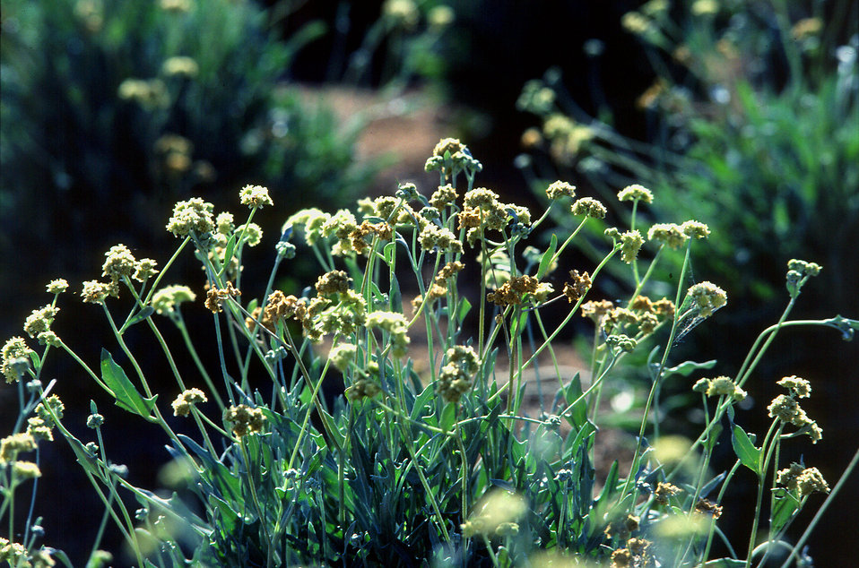
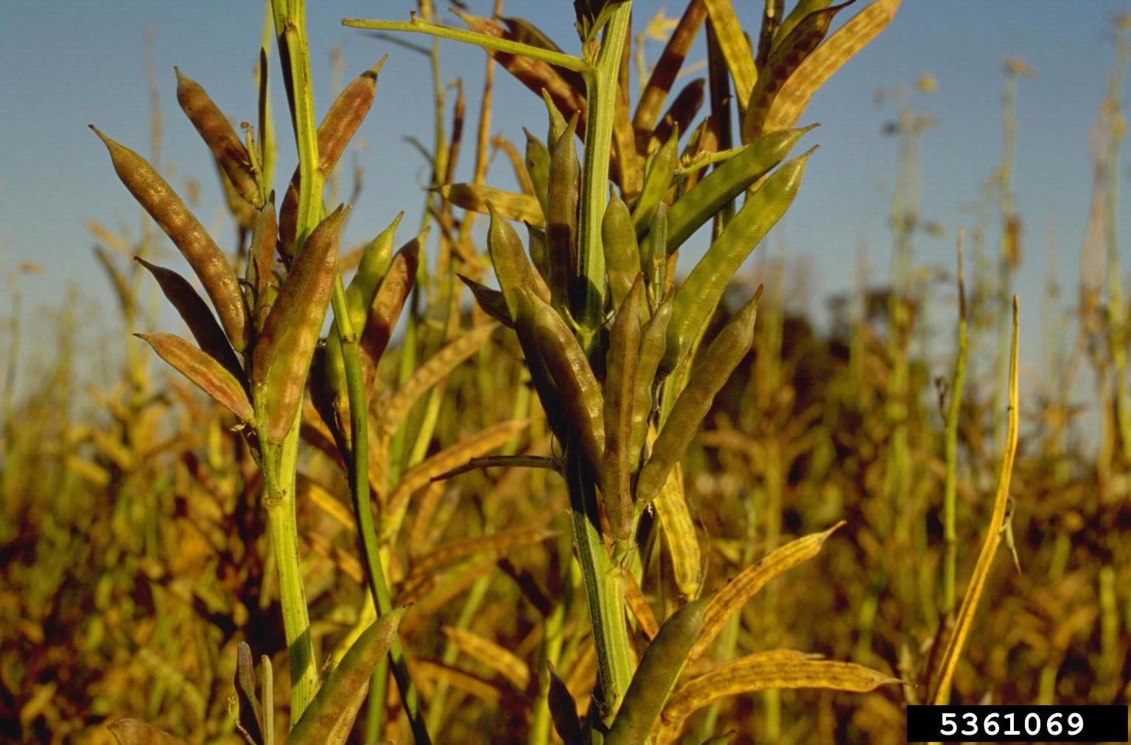
Tomatoes and Basil: Basil repels many pests that eat tomato plants, the two plants also taste great together.
Marigolds and Lettuce: Marigolds attract ladybugs, who will then eat the aphids that eat lettuce.
Possible Benefits:
Guayule and Guar: SBAR program- benefits of growing them together are being studied.

Slide 14
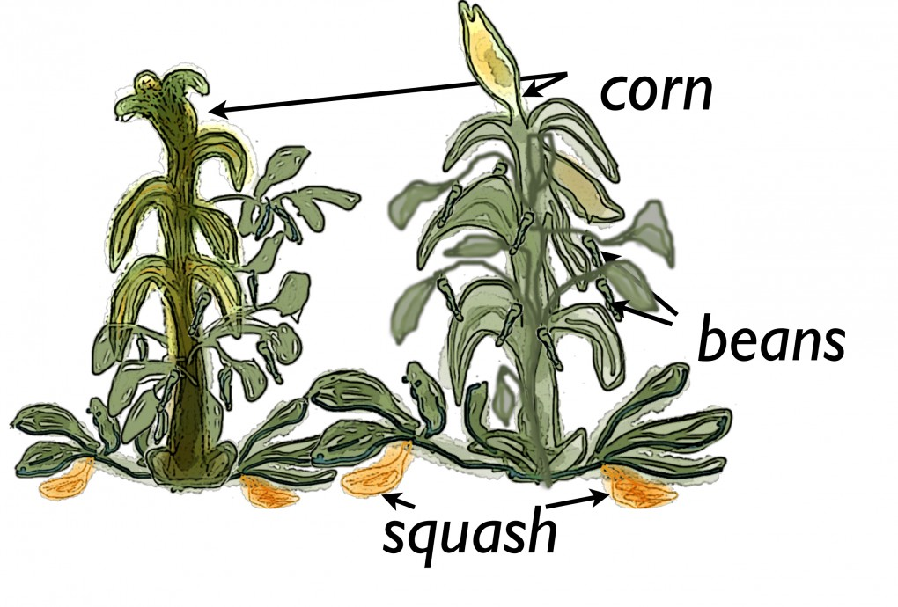
Three Sisters garden planning activity
Objective: In this activity, you will create a plan for your own Three Sisters garden. You will also find resources that can be used to make your plan a reality.
Use: worksheet and graph paper

Slide 15
Step 1: pick your plants
First, look at the list on the next slide and choose 1-3 types of plant from each column. The three suggested varieties are seeds that are native to the southwest region, but you can also look at https://www.nativeseeds.org/pages/seeds for more options or look at native seed specialists in your area.

Slide 16
Example Seed List: Find more varieties at https://www.nativeseeds.org/pages/seeds
naadáá'/Qaa-o/Maiz/Corn Southwestern native varieties | Naaʼołí /Paapu/Frijoles/Beans Southwestern native varieties | Naayízí/Batanga/Calabaza/Squash Southwestern native varieties
Navajo Copper | New Mexico Bolita | Tarahumaran Pumpkin
Flor del Rio | Hopi Purple String | Calabaza de las Aguas
Tarahumaran Maiz caliente | Hawol Pima Orange | Navajo Hubbard
Casados Multicolor | Howur Pima Beige | Papalote ranch cushaw
Alternative sister to corn: amaranth or sunflowers |  | Alternative sister to squash: melons
Tarahumara Okite amaranth |  | Santo Domingo native melon
Havasupai small-seeded sunflower |  | Hopi Casaba melon
Notes:
The region where you are located will have a major effect upon what seed varieties you may want to try. Many of the native seed varieties listed at Native Seed SEARCH are adapted to the specific environments of the native nation that developed the seeds.

Slide 17
Step 2: Map your Garden
Scale
1 square= 6 inches
Using graph paper, decide how large the space is that you could plant with a three sisters' garden. If you have a backyard or school space, you can measure the length and width of the area.
Next, figure out your scale for your drawing. If you have a large area, you may want to make each square on your graph paper equal to 1-2 feet, with a small area, each square could be 6 inches.
Key
C= corn
B= beans
S= squash
M=melon
A= Amaranth

Slide 18
3. There are many different ways you can set up a Three Sisters garden, so be creative! However, follow these rules:
Corn is tall, so should be in the center of your three sisters garden so it does not block light for the other sisters.
Corn seeds should be planted 6 inches (o.5 feet) apart or more from other corn seeds.
Squash spreads out across the ground, so squash must be planted 3 feet from other plants including other squash plants.
Bean seeds should be planted 3-12 inches from corn and other bean seeds.
Make sure to add space for a walkway through a larger garden so you can get to all the plants!
6"
3'
3-12"

Slide 19
Map Example
Scale
1 square= 6 inches
S
M
This is one example of a three sisters' design.
Your garden can be any shape but remember:
follow the 5 rules
include a scale
Include a key
Be creative!
Follow up- put your maps up on the wall in your learning space and compare designs. Pick a design that someone else created that you like and tell them something you like about their design.
A
B
B
B
B
C
C
S
B
B
B
A
A
B
24"
S
M
Key
C= corn
B= beans
S= squash
M=melon
A= Amaranth

Slide 20
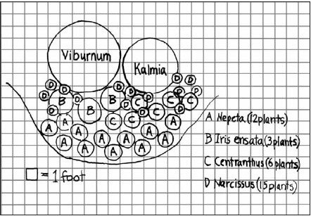
Map Example 2
This is an example of a flower garden design but it can give you ideas on how to draw your plan and label your plants.

Slide 21
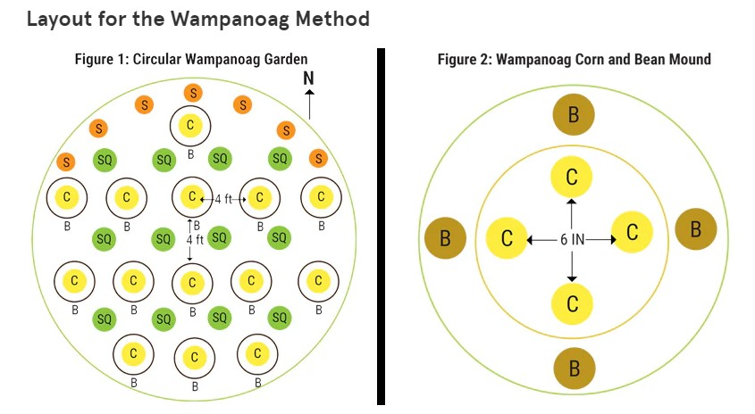
Map Example 3: Wampanoag Methods
Source: https://www.groworganic.com/blogs/articles/three-sisters-companion-planting-method

Slide 22
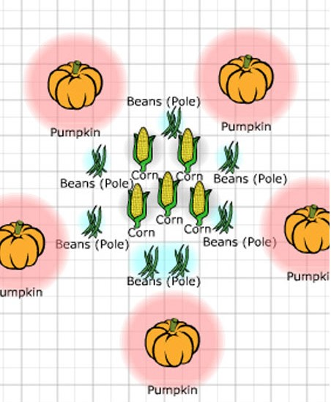
Share Design Ideas
Hang the garden maps up on the wall in your learning space and compare designs.
Pick a design that someone else created that you like and tell them something you like about their design.

Slide 23
Leveling Up
All three sisters are warm season crops. When planted together, there is a definite order to which sister you plant in order. Think about what you have learned about the three sisters-
A) Which sister would you plant first? Why?
B) Which sister would you plant second? Why?
C) Which sister would you plant last? Why?

Slide 24
Leveling Up- Answers
Corn is planted first, so it can grow tall over the other crops.
Beans are planted when the corn is a few inches tall so it can climb the corn stalks.
Squash is planted last after the beans have emerged from the soil, so the large leaves don't block the growth of the other sisters.

Slide 25
Exit Ticket
Directions: Go to https://www.nativeseeds.org/pages/seeds and pick 2 seed packets for each of the plants you chose for your three sisters' garden. Add them to your cart on the website or add up the total price on your own.
1. How much would it cost to purchase seeds for your garden?
2. Where and when could you plant this garden? Is there a community calendar for planting in your community?
Notes:
1. Follow up question: Are there any other items that you would need to purchase to plant this garden?
2. Follow up question: If you have space where you live to plant a garden, are there any barriers preventing you from planting? If you do not have the space where you live, can you think of a school, community center, or relative's house where you could plant this garden?

Slide 26
Free Seeds for Schools
Apply for a community seed grant here- https://www.nativeseeds.org/pages/community-seed-grants

Slide 27
Author Biography Matt Swanson is a lifelong Arizona resident and an educator with experience teaching science at the middle school and high school levels. He is now working for the Arizona State 4-H office as a Curriculum Specialist, where he continues to enjoy bringing learning experience to youth. He received both his undergraduate degree in philosophy and his graduate degree in science education at the University of Arizona.
Thank you to Juan Arias and the other members of the White Mountain Apache community who reviewed this lesson and provided invaluable feedback.
Thank you to Native Seeds SEARCH for their resources and outreach regarding native plant varieties in the Southwestern United States. Please visit their website at https://www.nativeseeds.org/.
Sustainable Bioeconomies for Arid Regions Center of Excellence: https://sbar.arizona.edu
Any opinions, findings, conclusions, or recommendations expressed in this PowerPoint lesson are those of the author(s) and do not necessarily reflect the view of the U.S. Department of Agriculture. Grant # 2017-68005-26867.

